Slide 1
CHRIS FORE
coach478@gmail.com
760.900.8401
EIGHTLACES.ORG
COACHFORE.ORG
SHIELDPUNT.COM
@coachfore

Slide 2
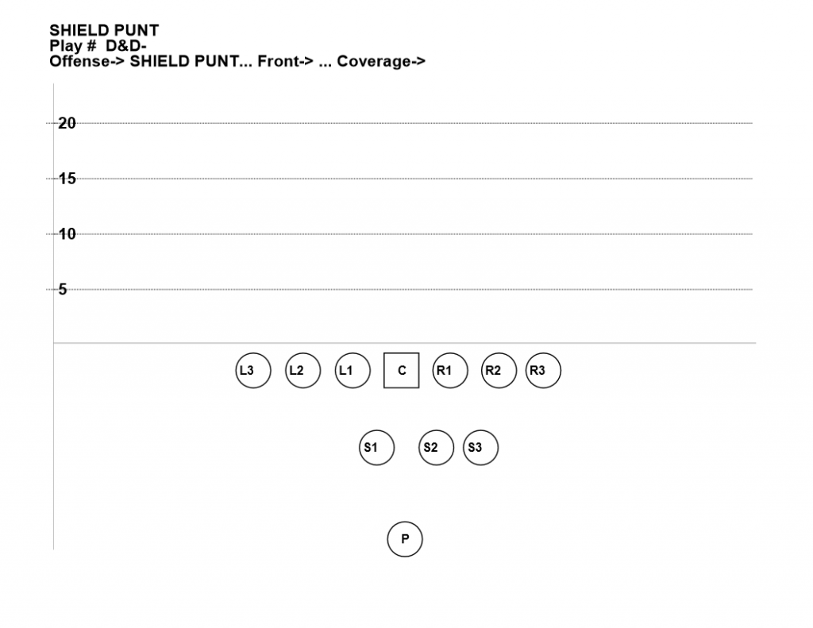
SHIELD PUNT
Maximizing Field Position,
Eliminating Returns
By Chris Fore, ShieldPunt.com
Costa Mesa Glazier Clinic - February 27, 2016

Slide 3
12 SEASONS
134 games
354 punts
3 blocked (‘02, ‘07, ‘14)
1 returned for a TD
Best Season = 38 punts - 14 return yds

Slide 4
2015 STATS

Slide 5
2014 STATS
33 punts
40 return yards allowed (1.2 avg)
Returns of 12 yds, -1 yard, 22 yds, 7 yds
1 blocked punt
ZERO return touchdowns!
Decreased punt return yards
by 85% this year!!
School record – punts inside 20 (7)

Slide 6
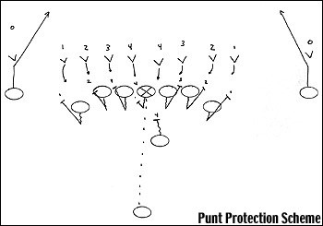
2001

Slide 7
6 DISADVANTAGES OF THE TRADITIONAL PUNT
1. Open Field Tackle tough to do
2. Five USELESS linemen after the kick
3. Just two real tacklers getting downfield
4. Return team can bring 8 guys
5. If returner is faster than your gunners, you lose valuable Field Position
6. Angles of the punt team creates automatic advantage; if they returner to sideline especially

Slide 8
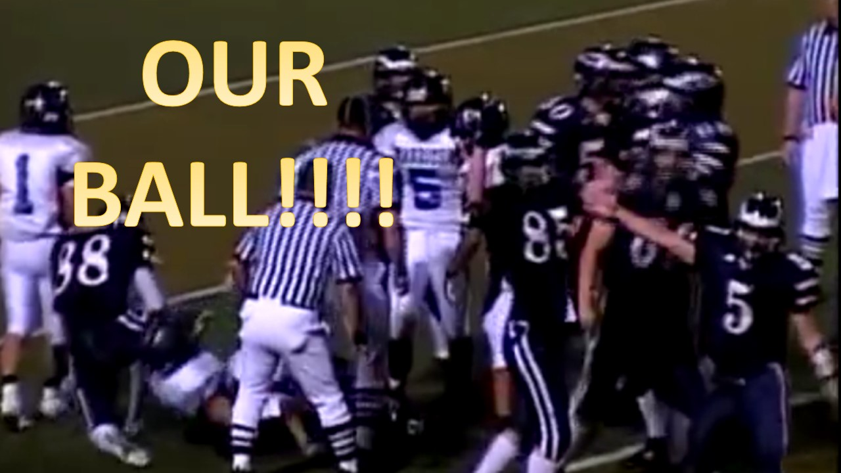
LOVE PUNT TEAM TURNOVERS!!

Slide 9
SHIELD PUNT

Slide 10
SHIELD PUNT ADVANTAGES
1. Get guys down the field FAST!

Slide 11
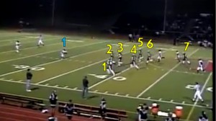

Slide 12
1
2
3
5
4
6

Slide 13
VIDEO CLIP
DOWN FIELD FAST

Slide 14
ADVANTAGES OF THE SHIELD PUNT
1. Get guys down the field FAST!
2. Simple formation used everywhere on field

Slide 15
ADVANTAGES OF THE SHIELD PUNT
1. Get guys down the field FAST!
2. Simple formation used everywhere on field
3. Very difficult to block

Slide 16
BRING 10 GUYS!!
http://www.youtube.com/watch?v=ImUQQzNh7mg&feature=youtu.be

Slide 17
Add video HARD TO BLOCK

Slide 18
ADVANTAGES OF THE SHIELD PUNT
1. Get guys down the field FAST!
2. Simple formation used everywhere on field
3. Very difficult to block
4. A lot more fake options

Slide 19
DISADVANTAGES OF THE SHIELD PUNT
1. A bad snap
2. Personnel – defensive guys, tired on D?
3. Shanked kick – Outcoverage the kick!
4. Backed up – if they bring all 11

Slide 20
Insert Bad Snap video clip

Slide 21
Insert Outcoverage

Slide 22
PERSONNEL
1. Front line seven guys – LBS/Safety types
2. Shield – big guys who can block

Slide 23
COACHING ASSIGNMENTS
Coach 1
Coach 2
Coach 3
Coach 4

Slide 24
ALIGNMENT

Slide 25
ALIGNMENT
FRONT LINE

Slide 26
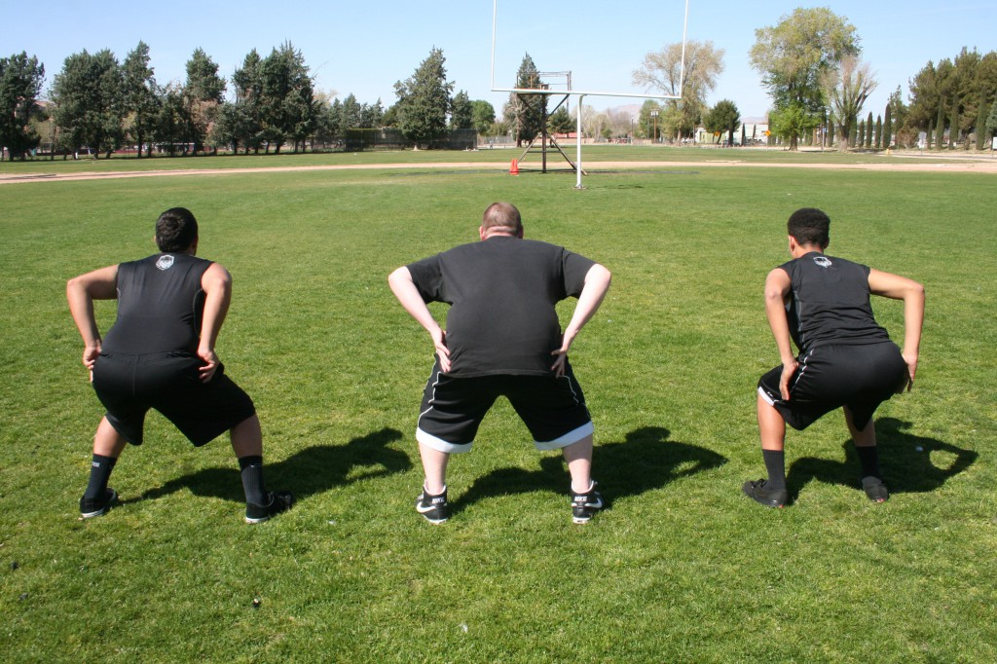
ALIGNMENT
FRONT LINE
L3
L2
L1

Slide 27
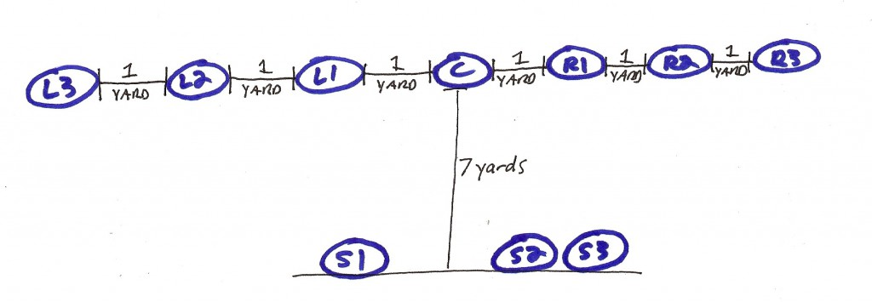
ALIGNMENT
SHIELD

Slide 28
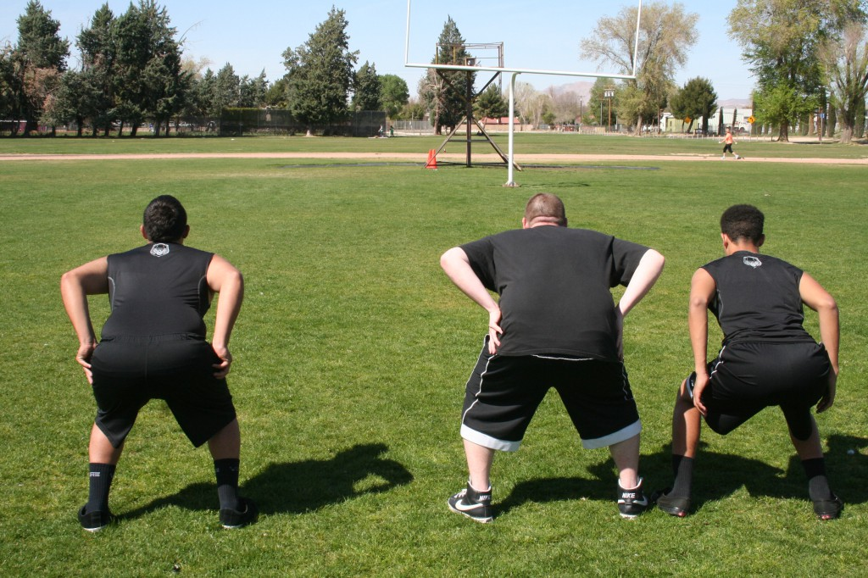
ALIGNMENT
SHIELD
S1
S2
S3

Slide 29
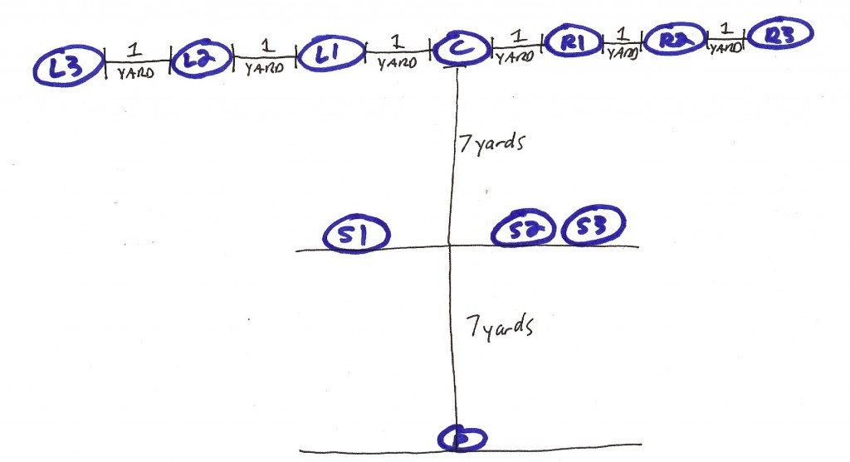
ALIGNMENT
PUNTER

Slide 30
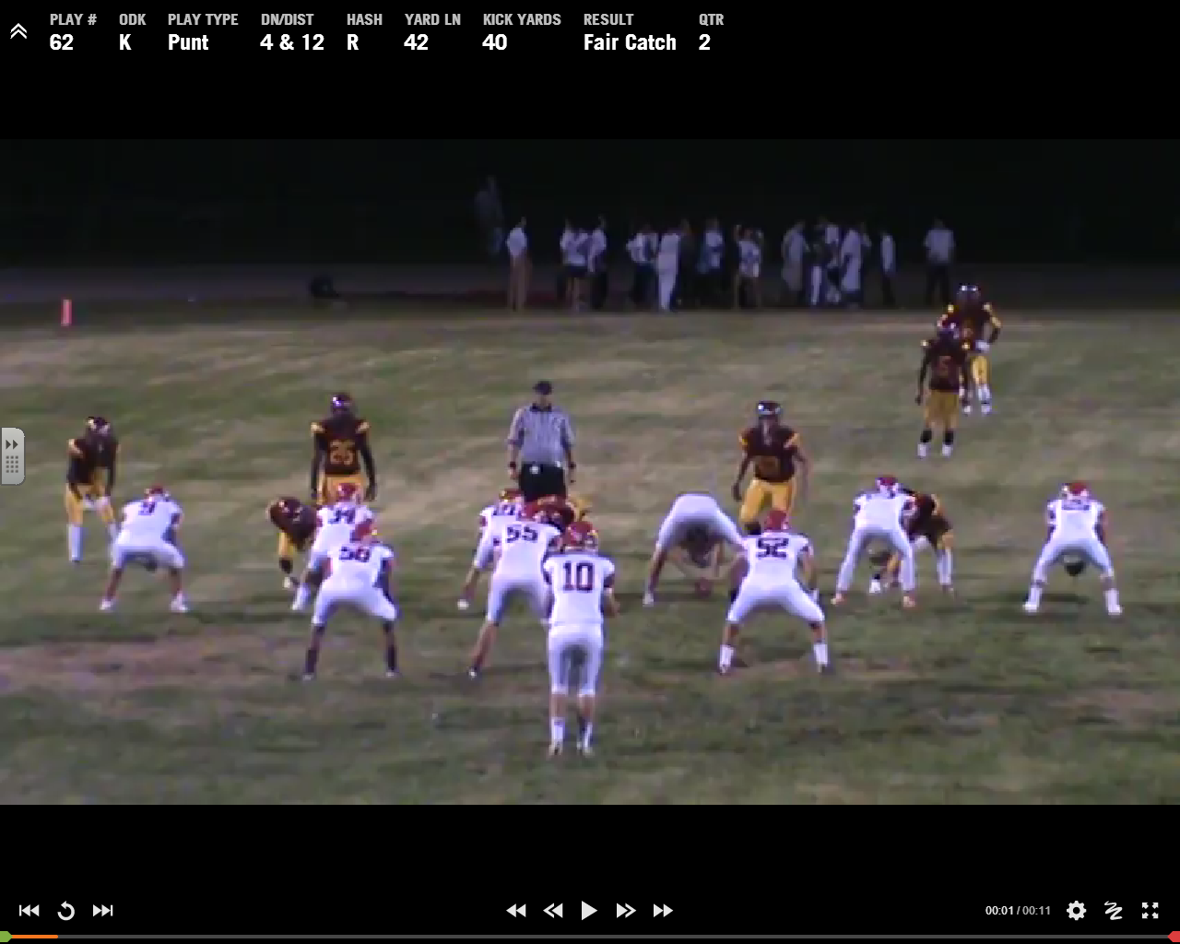
ALIGNMENT

Slide 31
ALIGNMENT

Slide 32
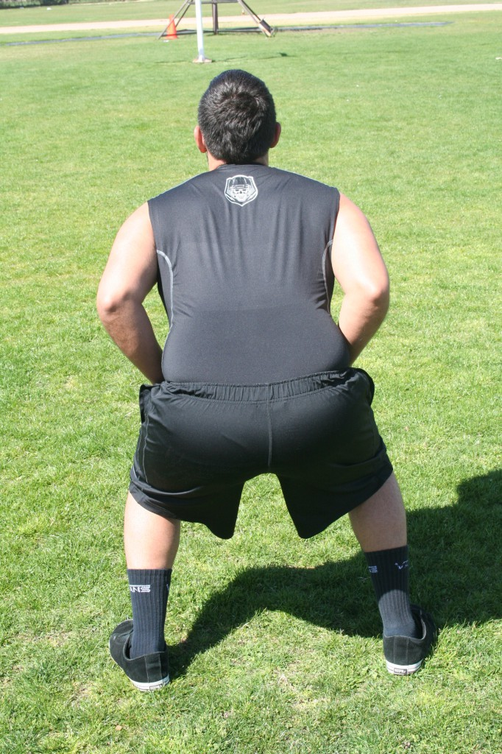
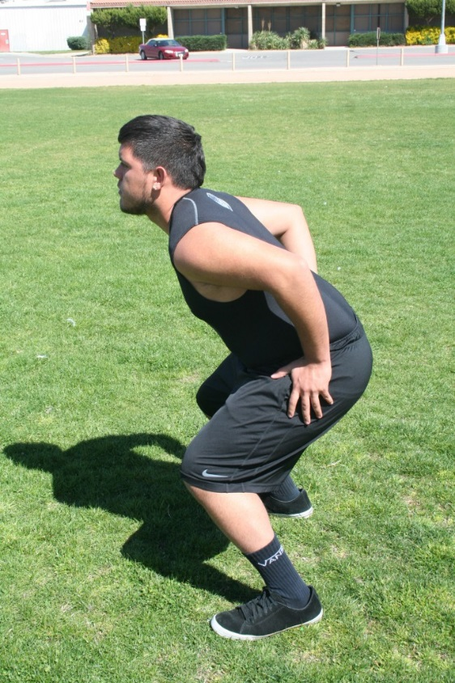
STANCE

Slide 33
HUDDLE
S2
L3
L2
L1
C
R1
R2
R3
S1
P
S3
Gets heels at 7

Slide 34
SNAPPING THE BALL
1. S2 is the “voice”

Slide 35
SNAPPING THE BALL
1. S2 is the “voice”
2. Make sure front line is SET

Slide 36
SNAPPING THE BALL
1. S2 is the “voice”
2. Make sure front line is SET
3. Make sure punter is SET and READY

Slide 37
SNAPPING THE BALL
1. S2 is the “voice”
2. Make sure front line is SET
3. Make sure punter is SET and READY
4. Make sure punter is SET and READY

Slide 38
SNAPPING THE BALL
1. S2 is the “voice”
2. Make sure front line is SET
3. Make sure punter is SET and READY
4. Make sure punter is SET and READY
5. Punter NODS and POINTS to S2 when READY

Slide 39
SNAPPING THE BALL
1. S2 is the “voice”
2. Make sure front line is SET
3. Make sure punter is SET and READY
4. Make sure punter is SET and READY
5. Punter NODS and POINTS to S2 when READY
6. S2 then says “Ready, Ready” to prepare for snap

Slide 40
SNAPPING THE BALL
1. S2 is the “voice”
2. Make sure front line is SET
3. Make sure punter is SET and READY
4. Make sure punter is SET and READY
5. Punter NODS and POINTS to S2 when READY
6. S2 then says “Ready, Ready” to prepare for snap
7. Ball is snapped on punter’s hands

Slide 41
AFTER THE SNAP: THE FIRST STEP
Steps have to be PERFECT

Slide 42
AFTER THE SNAP: THE FIRST STEP
11 seasons – 354 punts
Just 3 blocked – Less than 1%
All three times – bad first step!!
2002 – S3 – Did not step up and in
2007 – R3 – No right foot step
2014 – S2 – Did not step up and in

Slide 44
Add Serrano blocking punt here

Slide 46
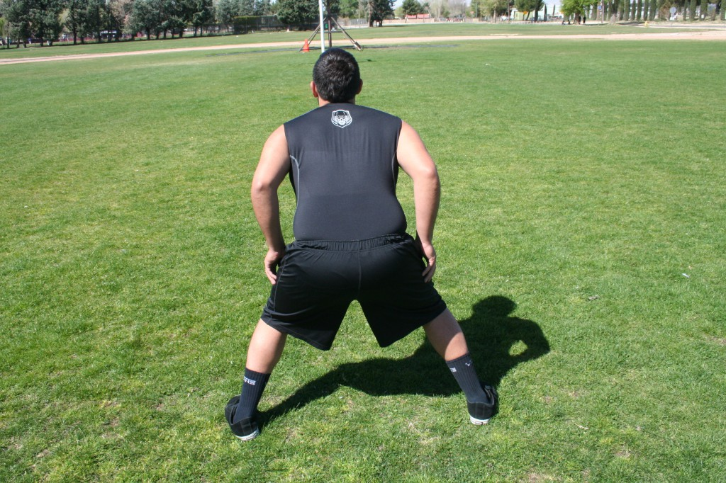
AFTER THE SNAP: THE FIRST STEP
L3 – L2 – L1

Slide 47
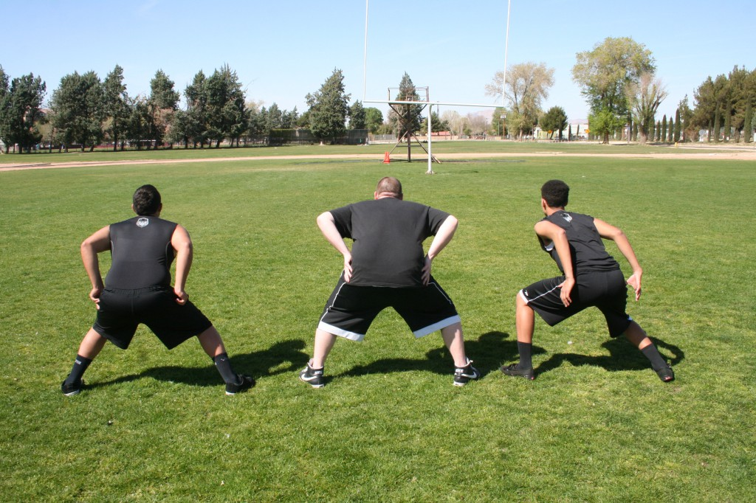
AFTER THE SNAP: THE FIRST STEP
SHIELD

Slide 48
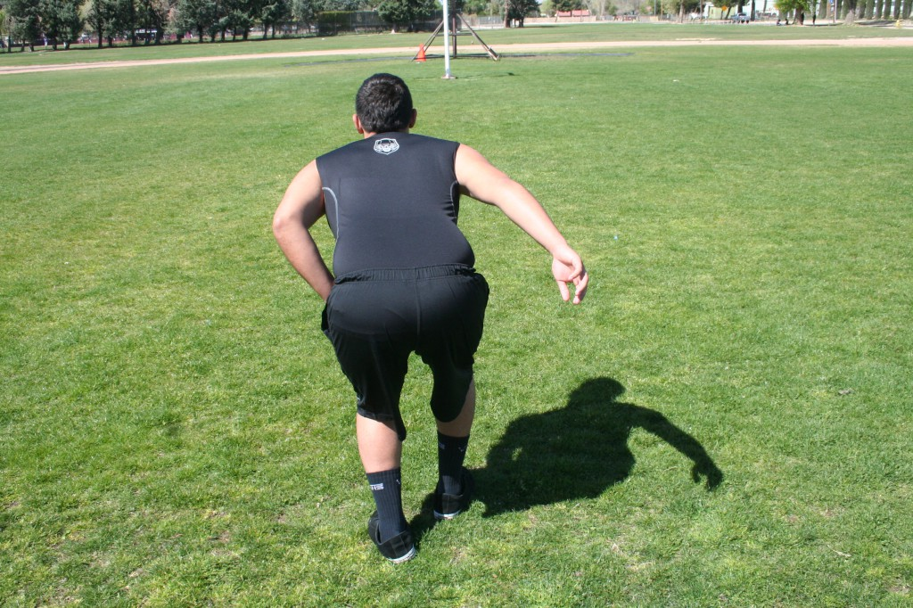
AFTER THE SNAP: SECOND STEP
L3 – L2 – L1

Slide 49
AFTER THE SNAP: SECOND STEP

Slide 50
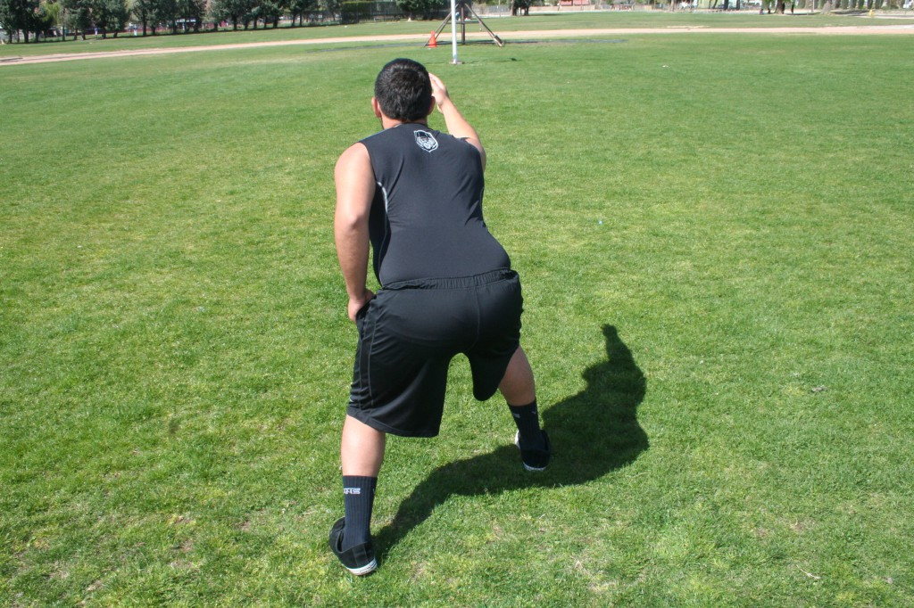
AFTER THE SNAP: SECOND STEP

Slide 51
AFTER THE SNAP: SECOND STEP

Slide 52
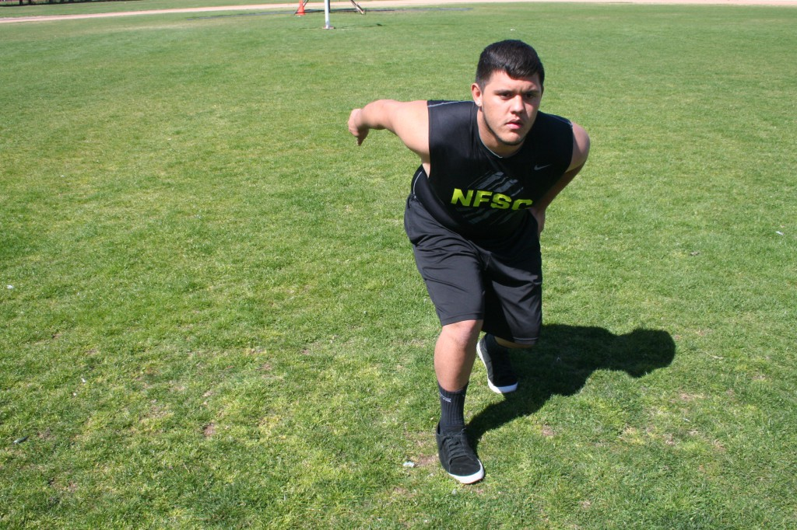
AFTER THE SNAP: SECOND STEP

Slide 53
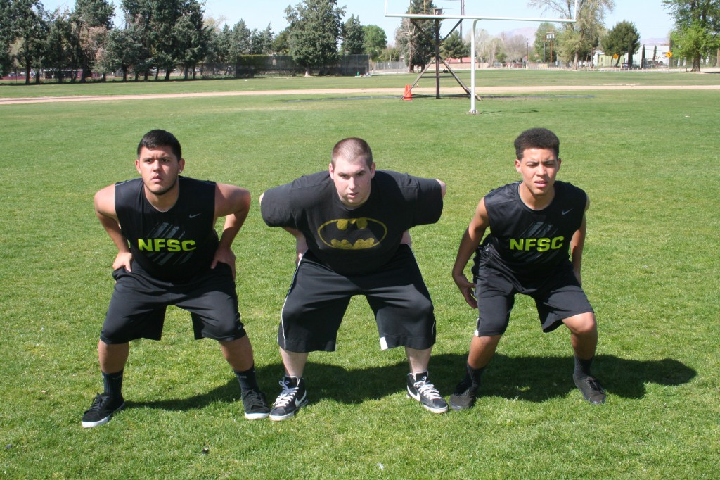
AFTER THE SNAP: SECOND STEP

Slide 54
Add “step” videos here

Slide 55
AFTER THE SNAP: THIRD STEP
Front line – Get UP field!
Shield – Hold your water!

Slide 56
GETTING OFF THE LOS

Slide 57
GETTING OFF THE LOS

Slide 58
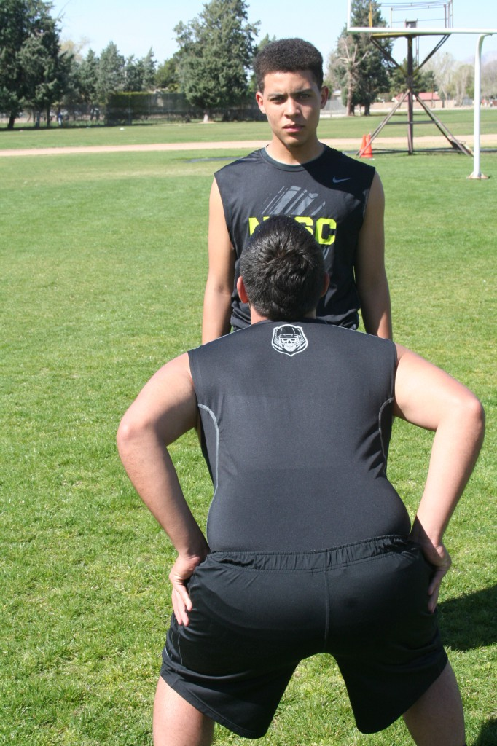
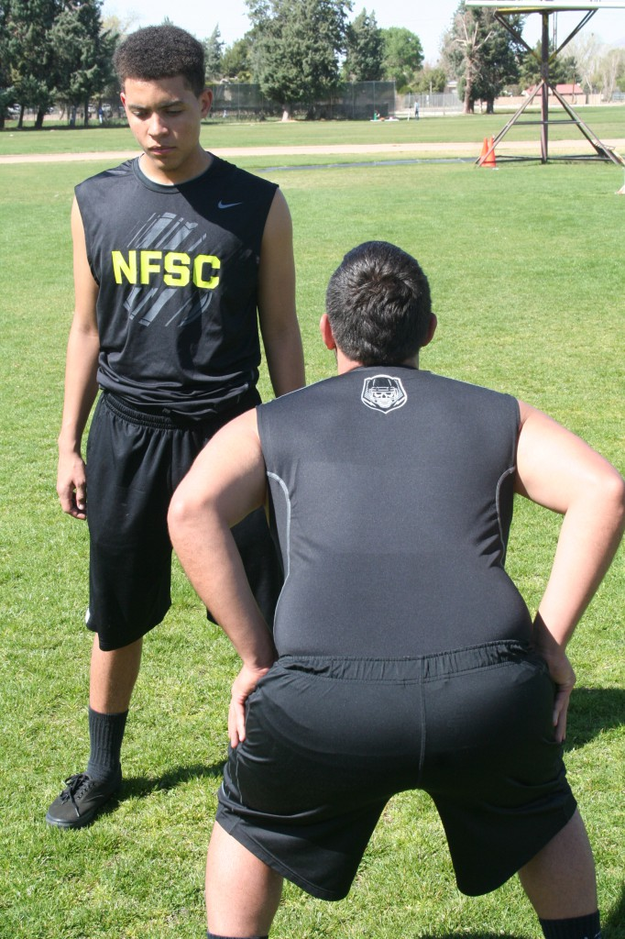
GETTING OFF THE LOS
NO!
YES!
L1
L1

Slide 59
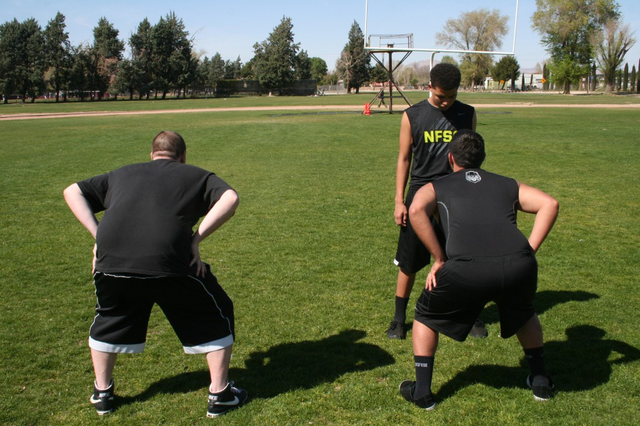
L1

Slide 60
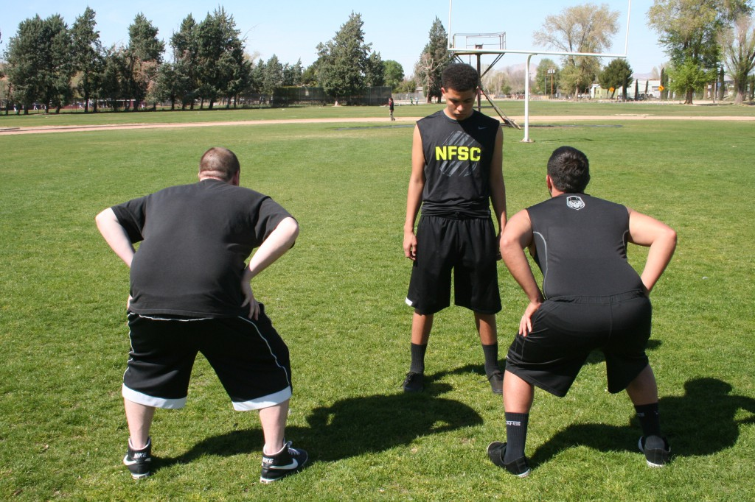
L1

Slide 61
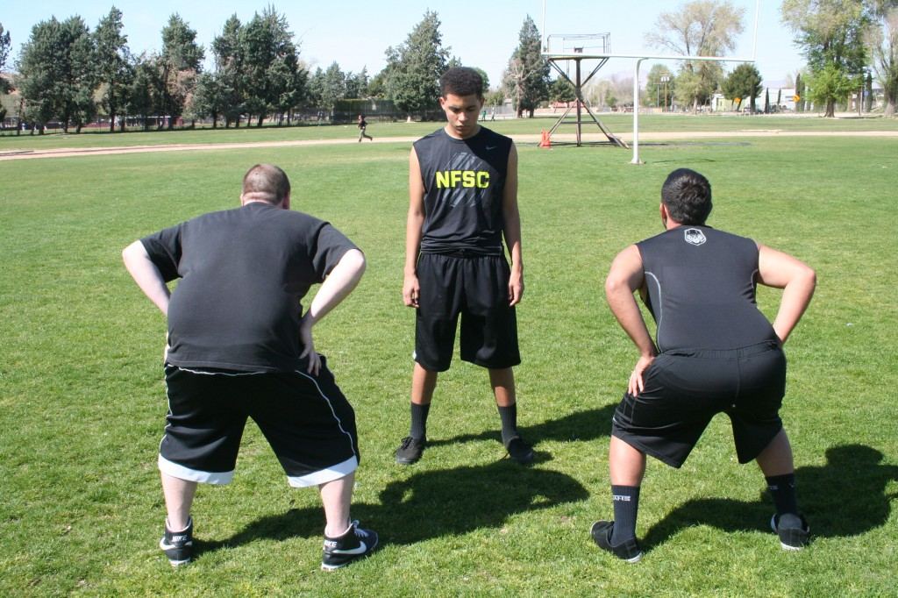
L1

Slide 62
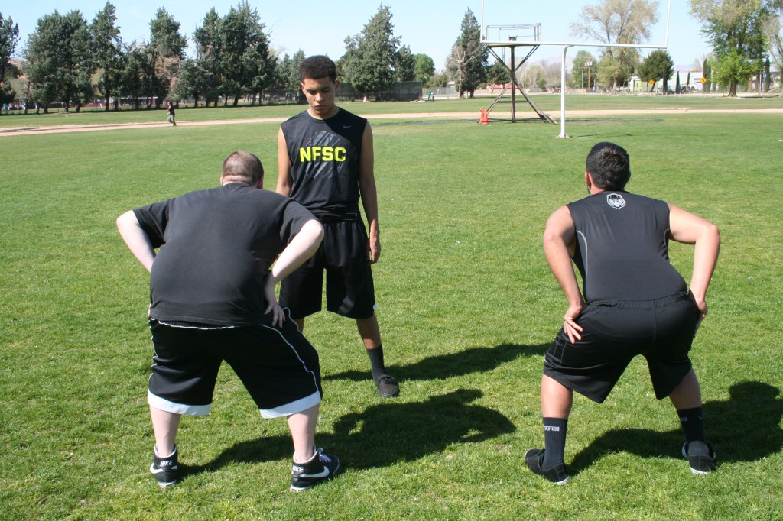
L1

Slide 63
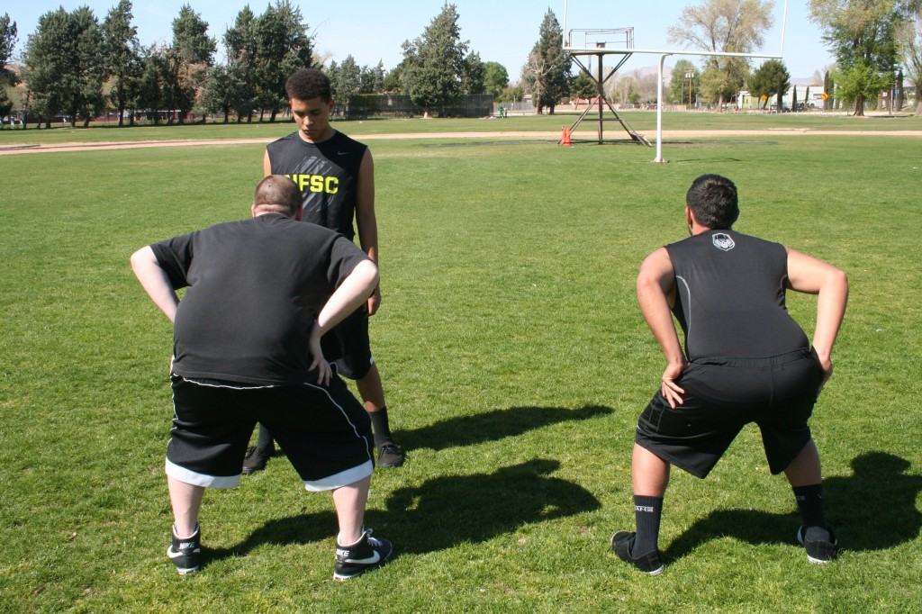
L1

Slide 64
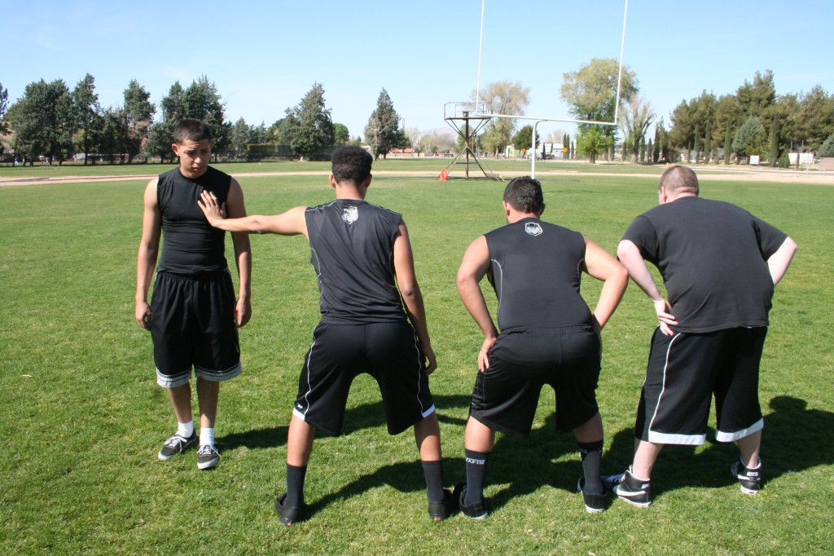

Slide 65
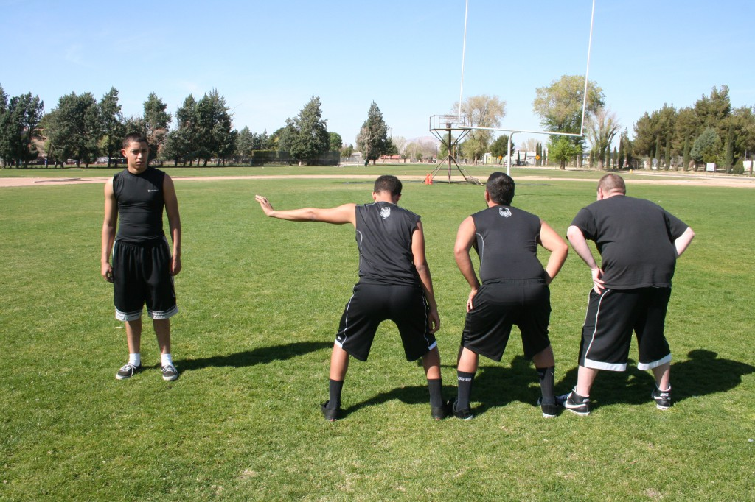
SHIELD – DO NOT CHASE MAN

Slide 66
Add who guys are blocking videos here

Slide 67
COVERAGE “LANES”

Slide 68
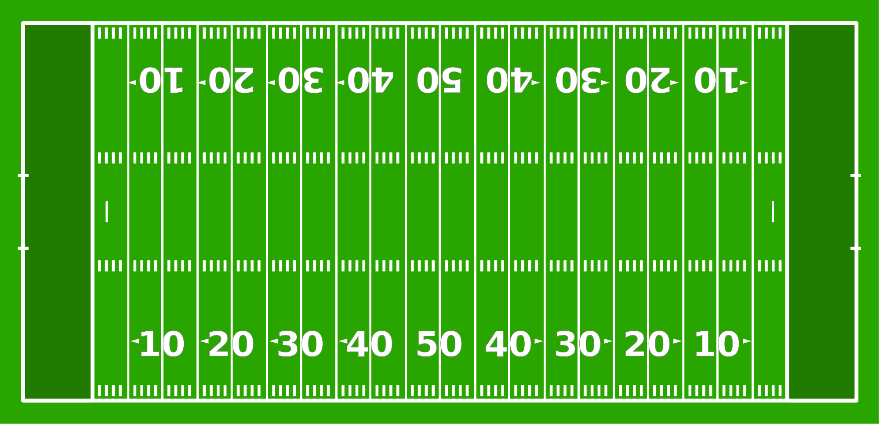
COVERAGE “LANES” DRILL

Slide 69
COVERAGE “LANES” DRILL

Slide 70
COVERAGE “LANES” DRILL

Slide 71
SHIELD PUNT E CLINIC
Features 19 chapters
Practice plans for first 5 days of install
28 instruction videos
Power point slides, and pictures
10 fakes
Every punt from one season
Many cut ups from college level
SHIELDPUNT.COM

Slide 72
CHRIS FORE
coach@coachfore.org
760.900.8401
EIGHTLACES.ORG
COACHFORE.ORG
SHIELDPUNT.COM
@coachfore

