Slide 1
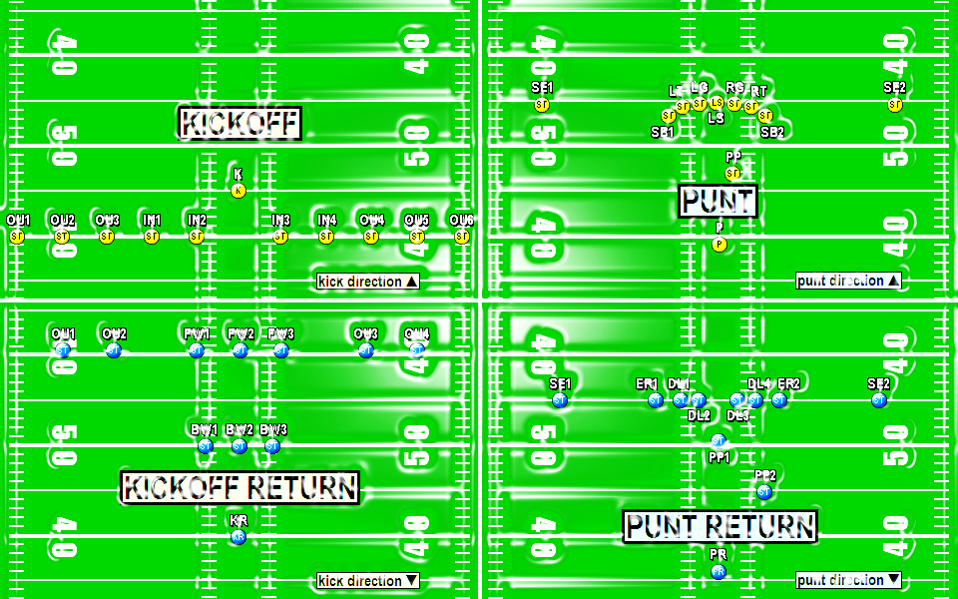
CHRIS FORE
chris@eightlaces.org
760.900.8401
EIGHTLACES.ORG
COACHFORE.ORG
SHIELDPUNT.COM
@coachfore

Slide 4
SPECIAL TEAMS ORGANIZATION

Slide 5
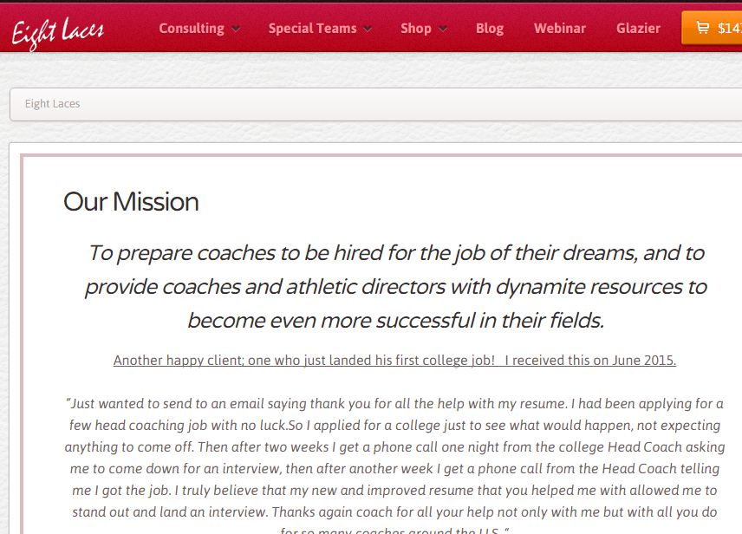

Slide 6
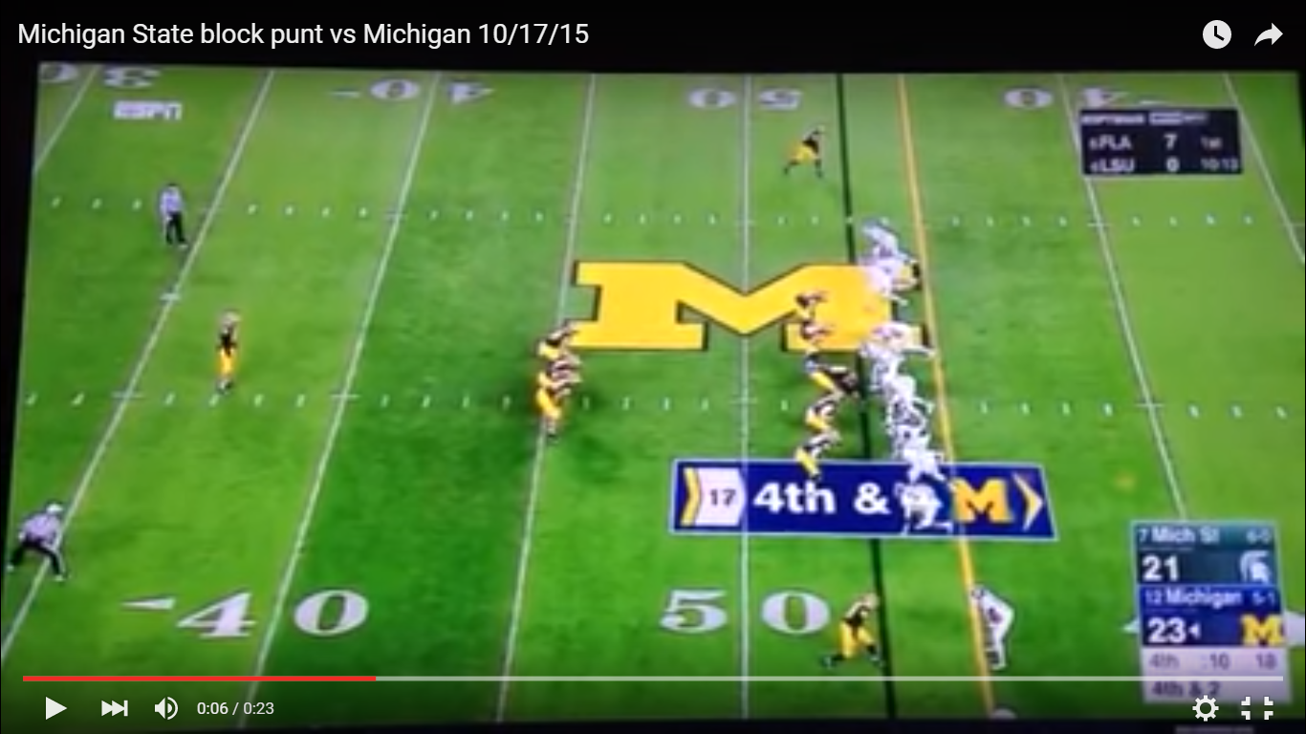

Slide 7
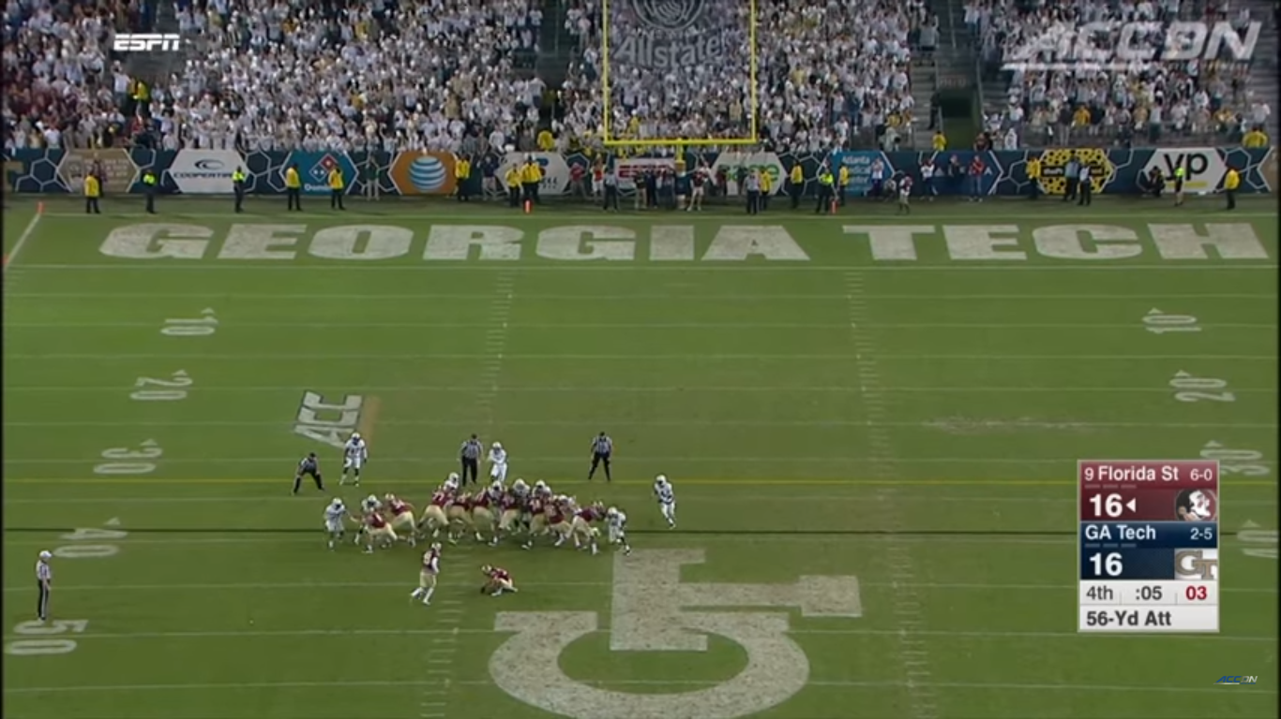

Slide 8
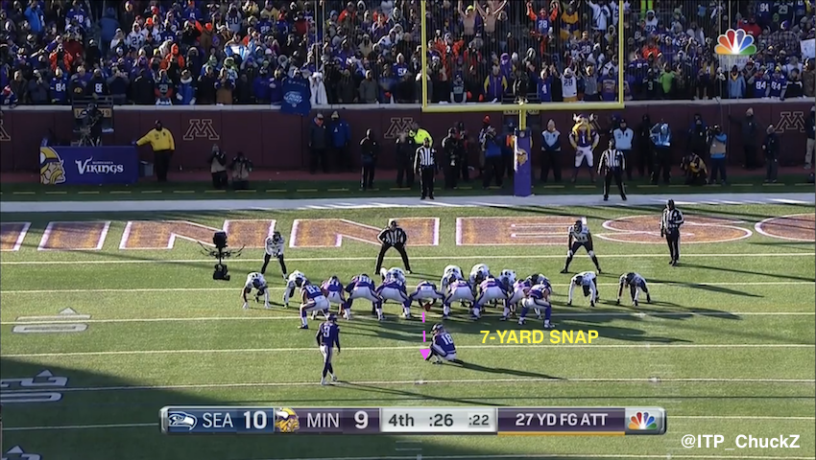

Slide 9
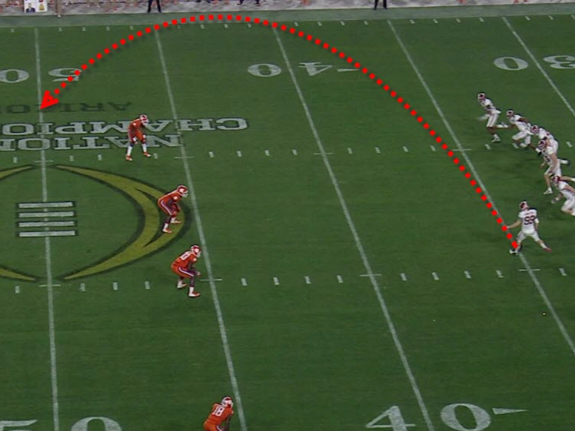

Slide 10
10 WAYS TO KNOW SPECIAL TEAMS IS NOT IMPORTANT!

Slide 12
10. The Head Coach squeezes Special Teams in at beginning or end.
9. The Head Coach is MIA
8. Staff treats the players as second class citizens.
7. Have just 1 or 2 of your staff coach Special Teams.
6. Program never has Special Teams’ meetings; those are just for Offense and Defense.

Slide 13
5. After a big loss you hear “We have to improve the kicking game.”
4. Coaches never even think about a Special Teams depth chart.
3. Never watch Special Teams film as a staff.
2. Equipment guy forgot to buy new tees in the off-season.
1. The team practices Special Teams just the day before the game! It must be Thursday!

Slide 14
8 years as HC/STC 5 as STC only
Currently, STC at Sultana HS (Hesperia, CA)

Slide 15
Record 3-7

Slide 16
Record 3-7
Source: MaxPreps

Slide 17
What A Difference A Vision Makes!

Slide 18
What A Difference A Year Makes!

Slide 19
DETERMINING THE BEST PHILOSOPHY FOR YOUR PROGRAM

Slide 20
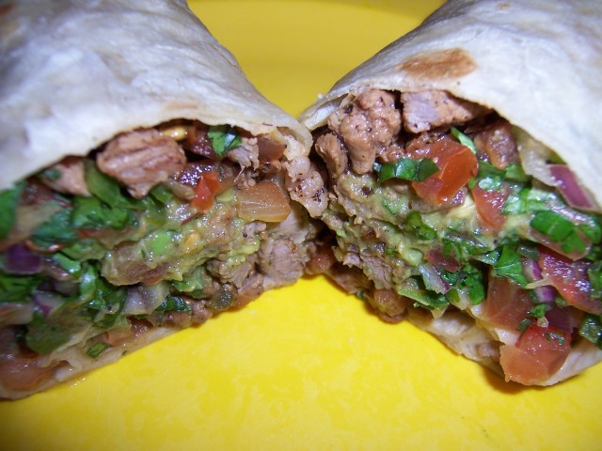
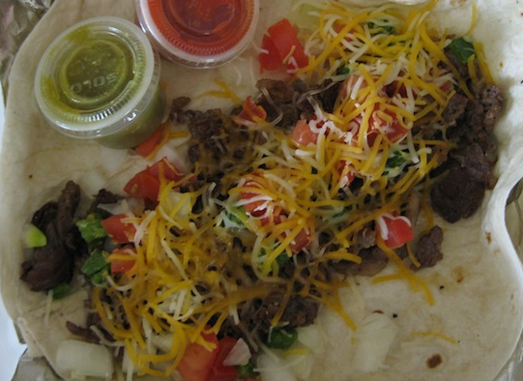

Slide 21
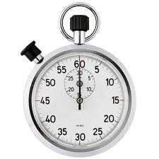
PHILOSOPHY?
1. Time Spent
OR

Slide 22
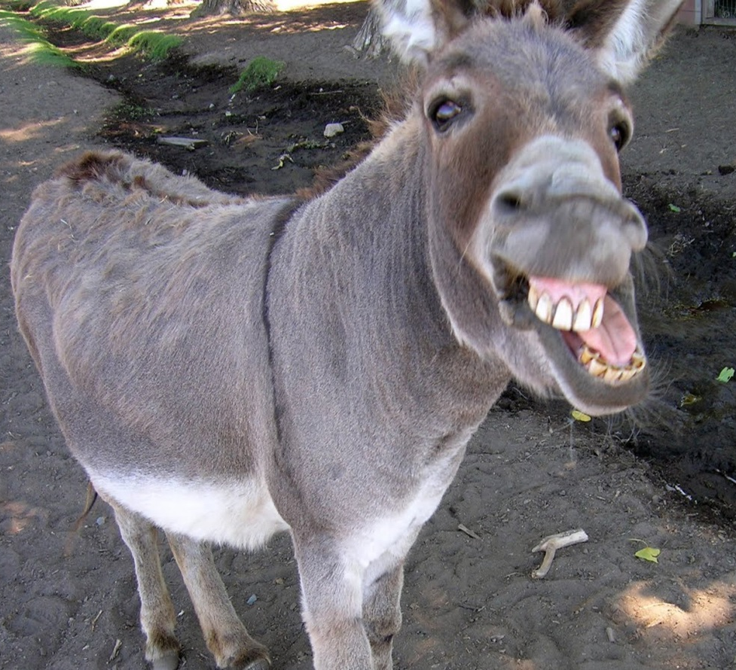
PHILOSOPHY?
OR
2. PERSONNEL

Slide 23
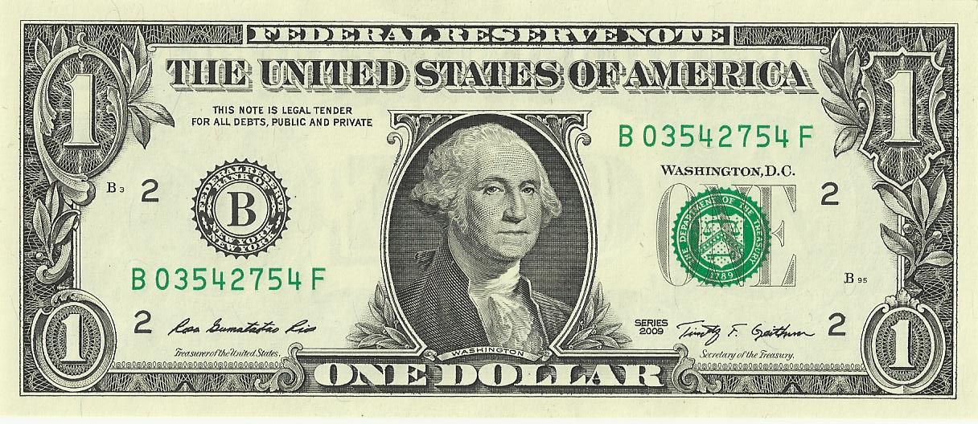
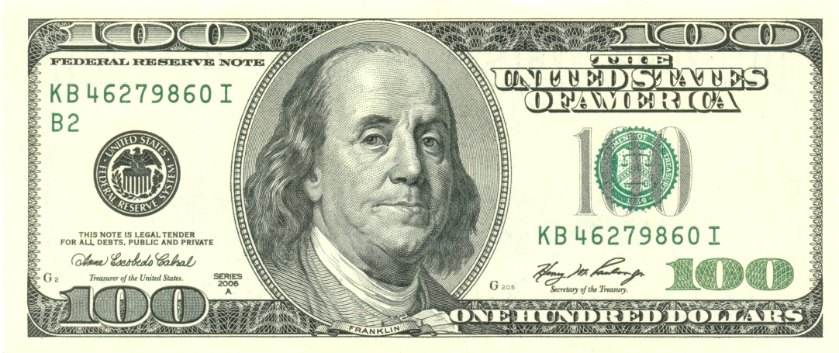
PHILOSPHY?
3. Coach’s Investment
OR

Slide 24
PHILOSPHY?
3. Coach’s Investment
HC, OC, DC, going to have an STC? Or job share?

Slide 25
HOW TO EVALUATE YOUR SPECIAL TEAMS FROM LAST SEASON

Slide 28
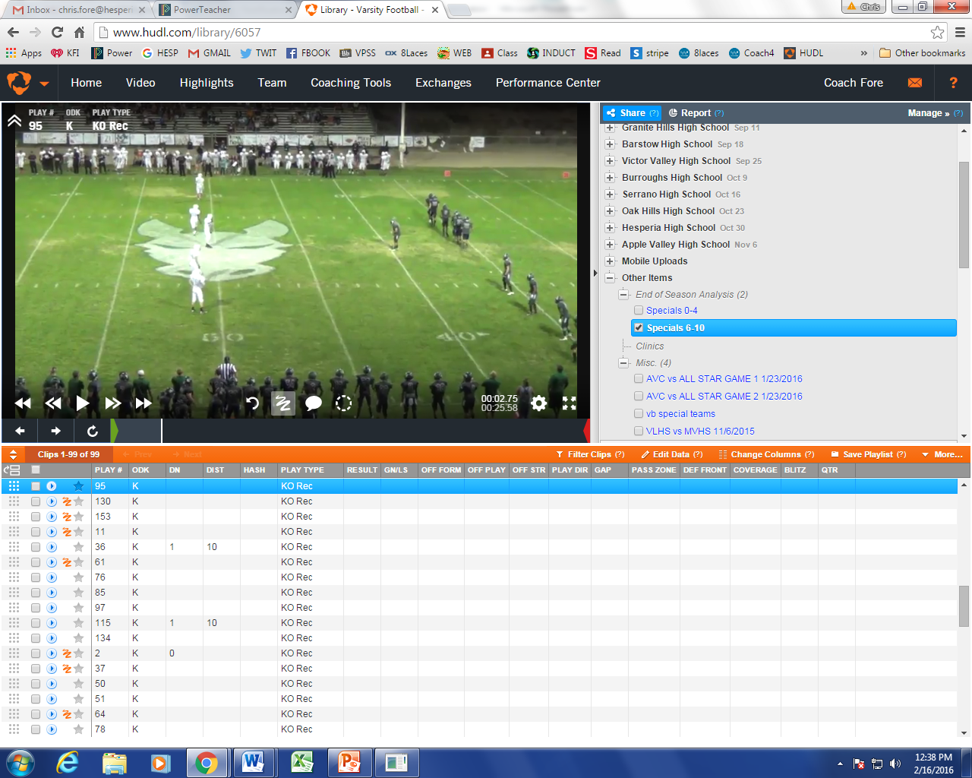

Slide 30
EVERY
KICKOFF
OF THE
YEAR

Slide 31
EVERY
KICK RETURN
OF THE
YEAR

Slide 33
STRUCTURING YOUR SPECIAL TEAMS DURING TRAINING CAMP

Slide 35
STRUCTURING YOUR SPECIAL TEAMS DURING GAME WEEK

Slide 36
WEEK AT A GLANCE

Slide 37
THURSDAY

Slide 38
SCOUTING YOUR OPPONENT IN SEASON

Slide 39
1. Utilize

Slide 40
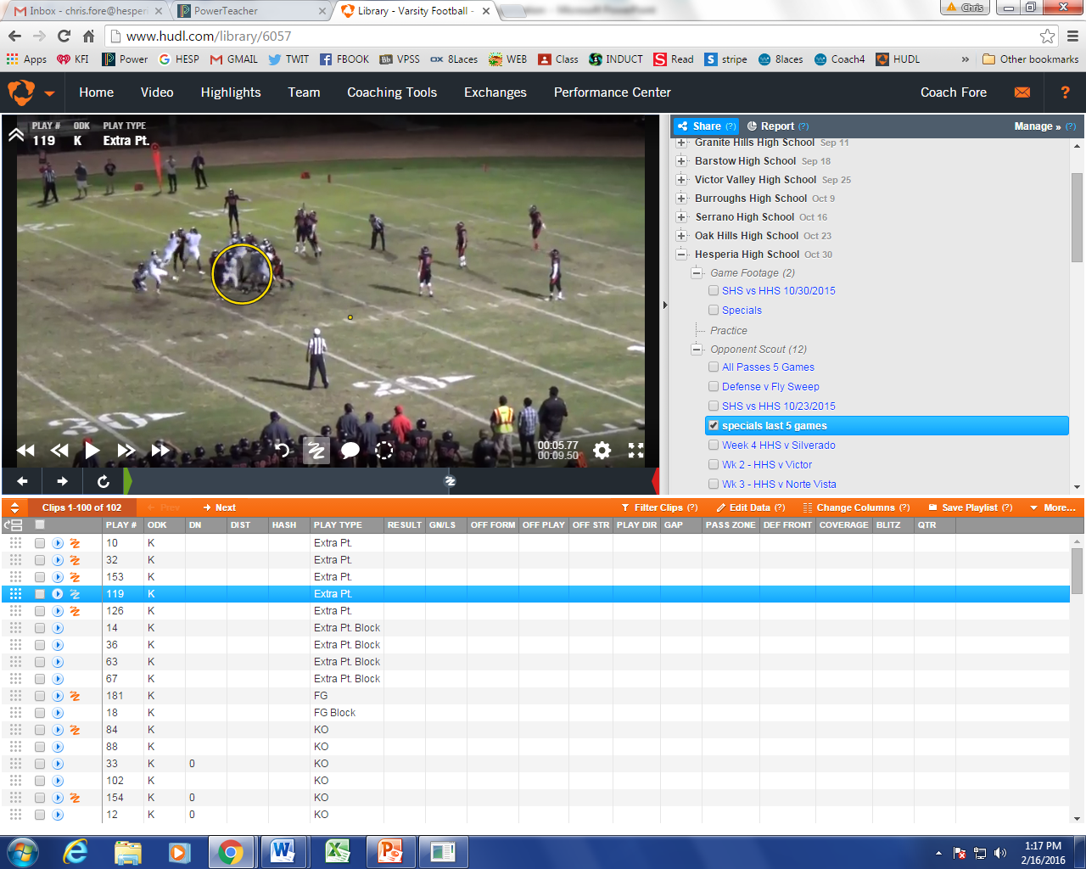

Slide 41
KICK RETURN v. CRESPI
Average start of 27 yard line
Gained 9.25 return average; 4 returns
Longest return: 18 yards

Slide 42
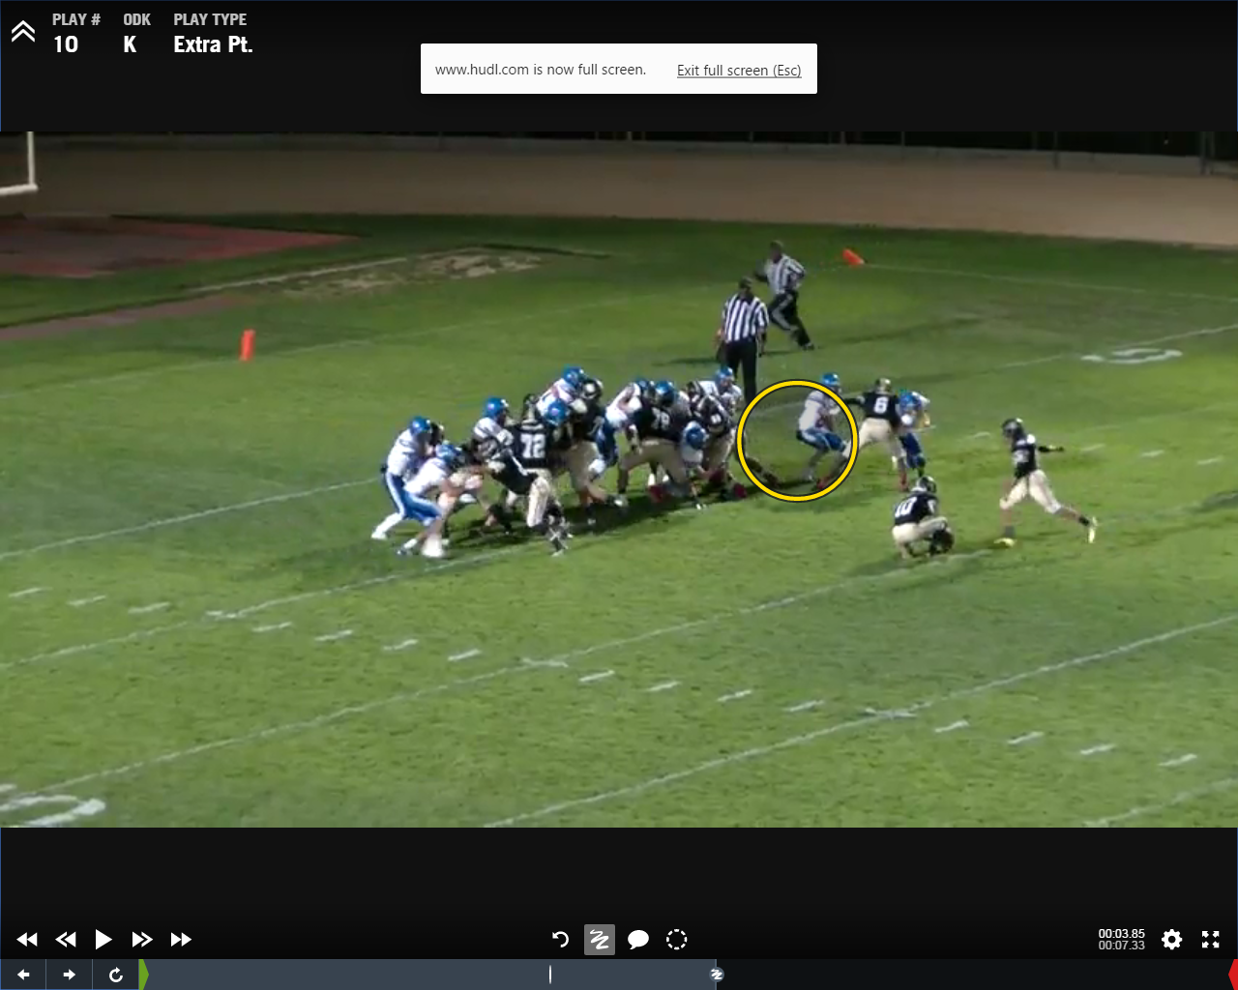

Slide 43
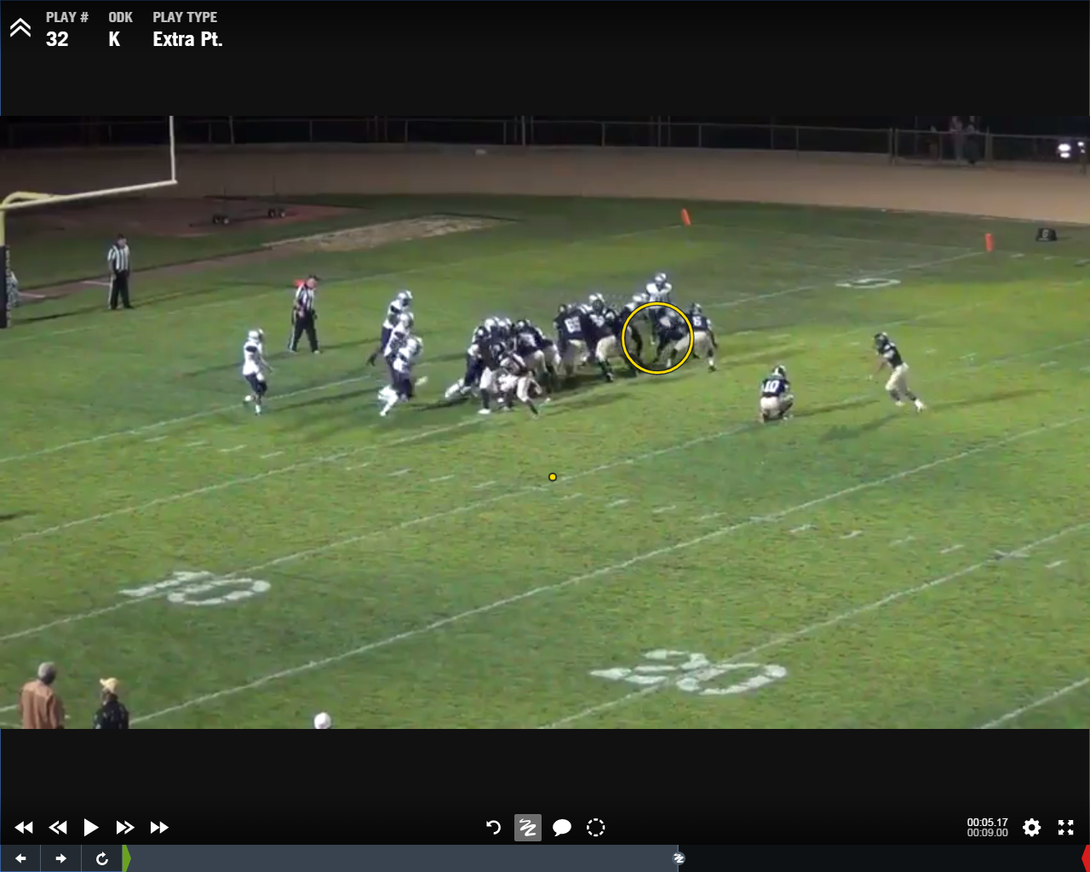

Slide 44
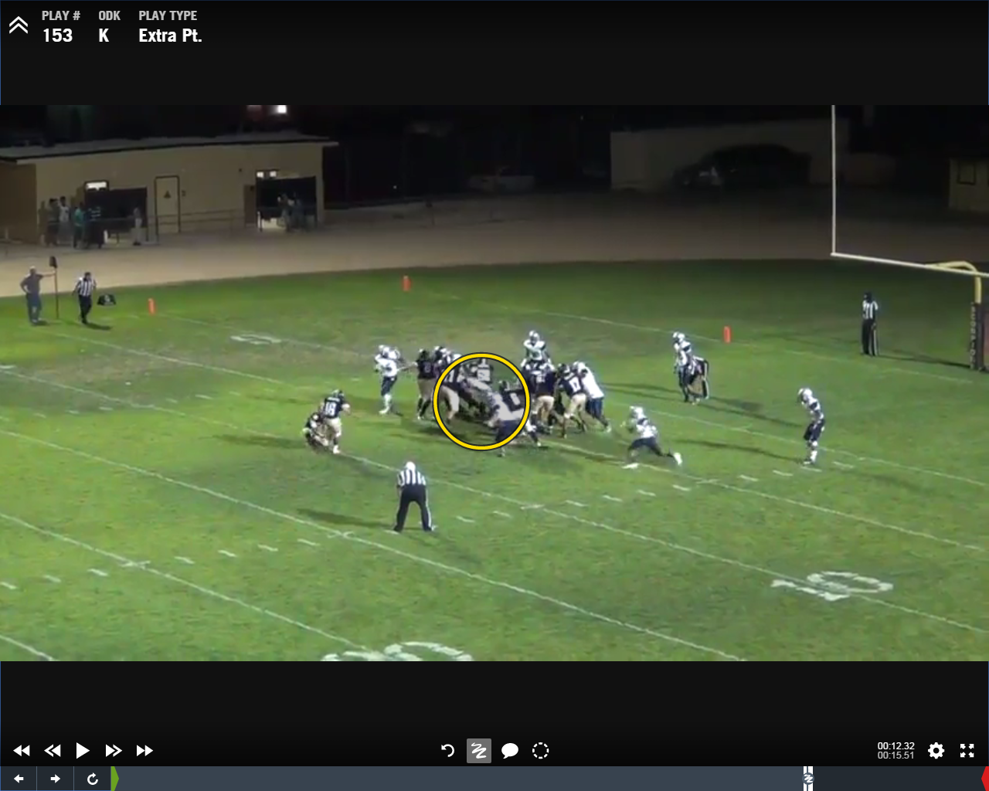

Slide 45
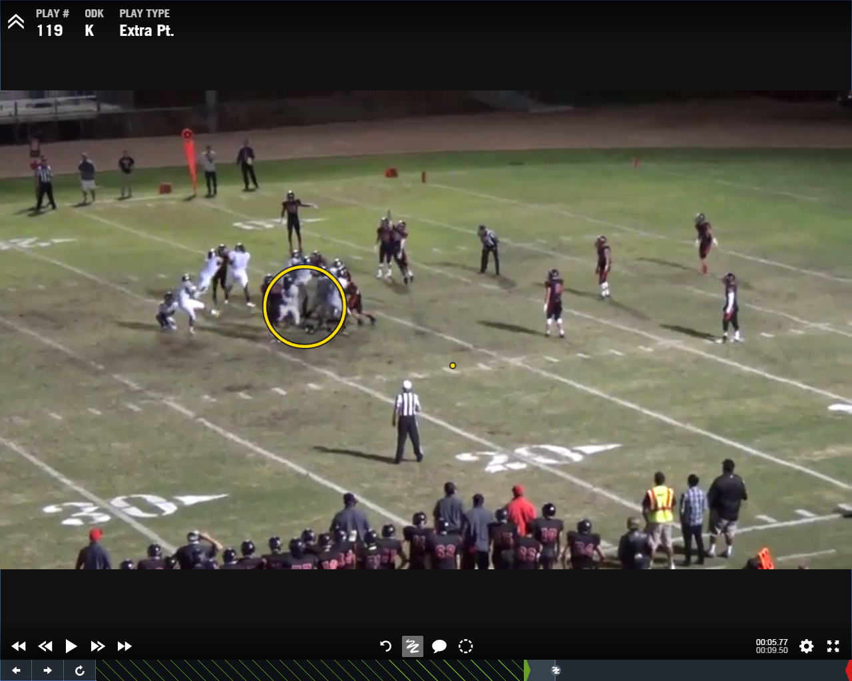

Slide 46
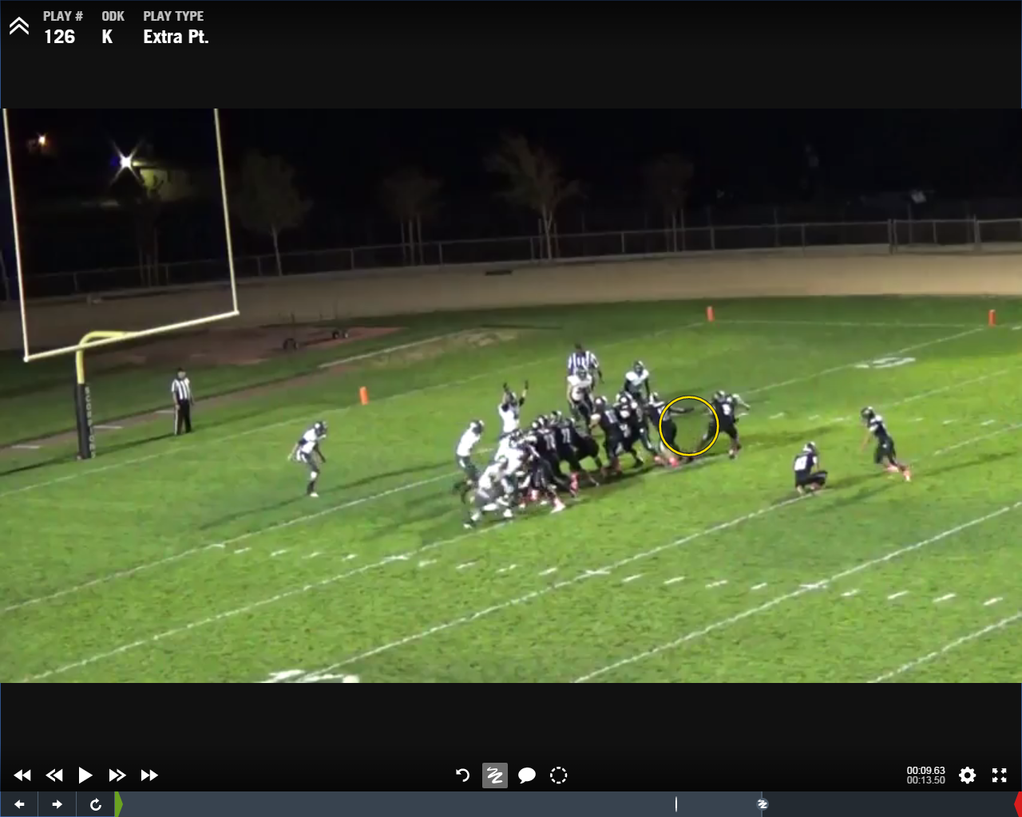

Slide 47
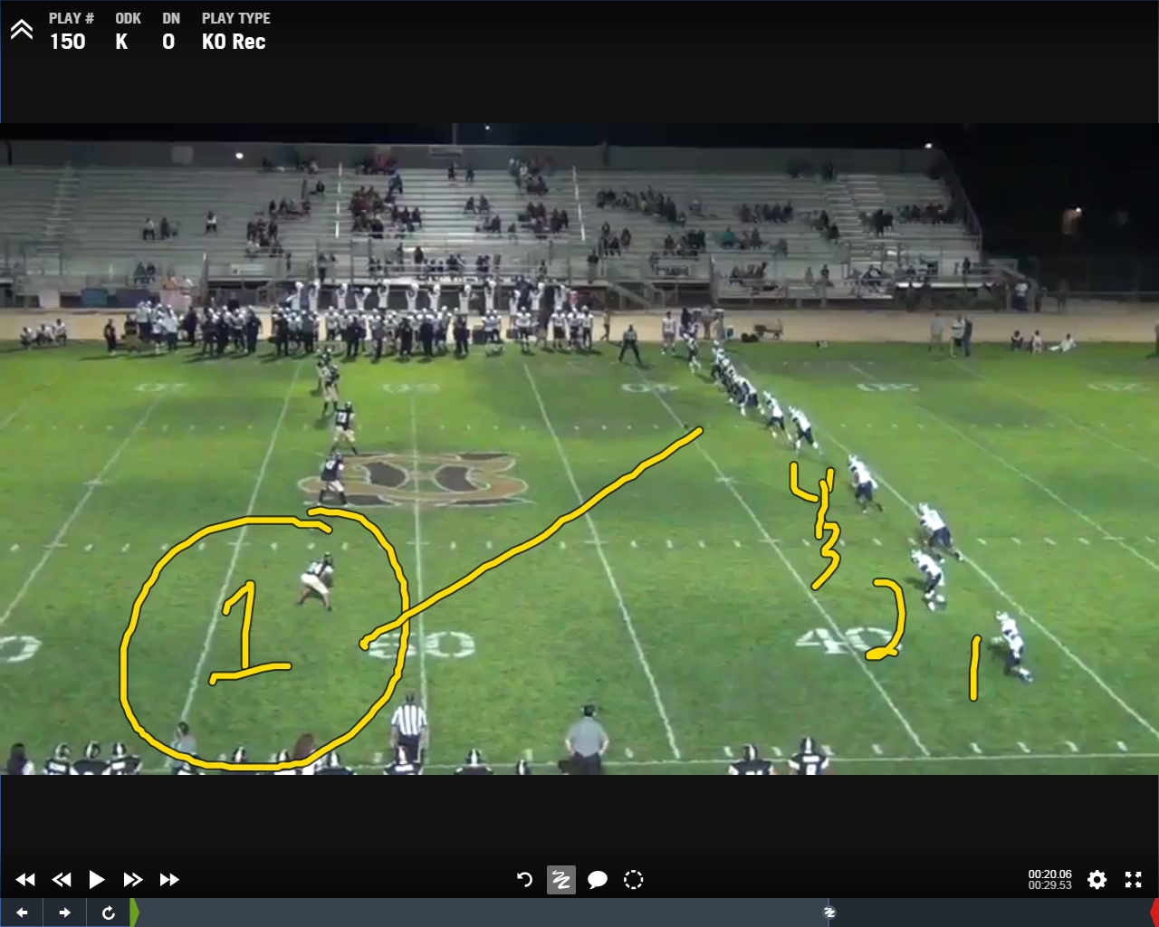

Slide 48
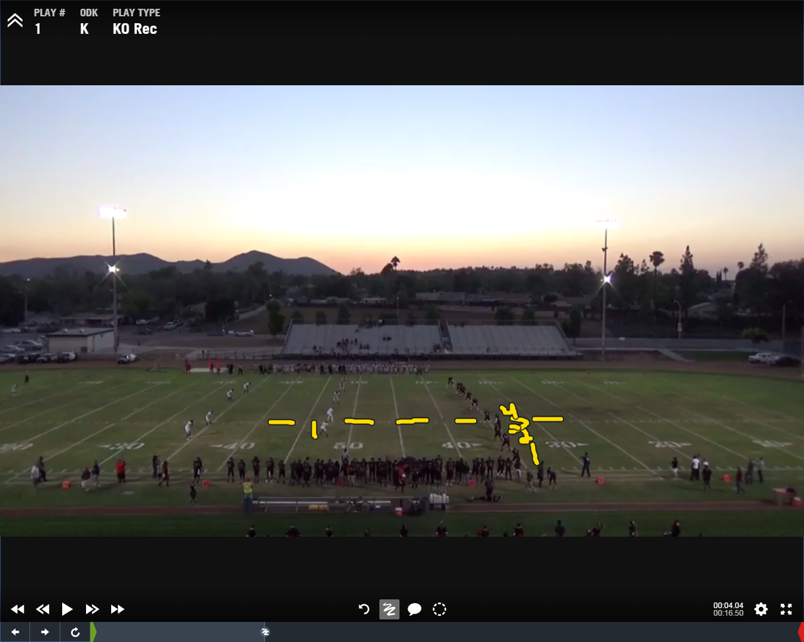

Slide 49
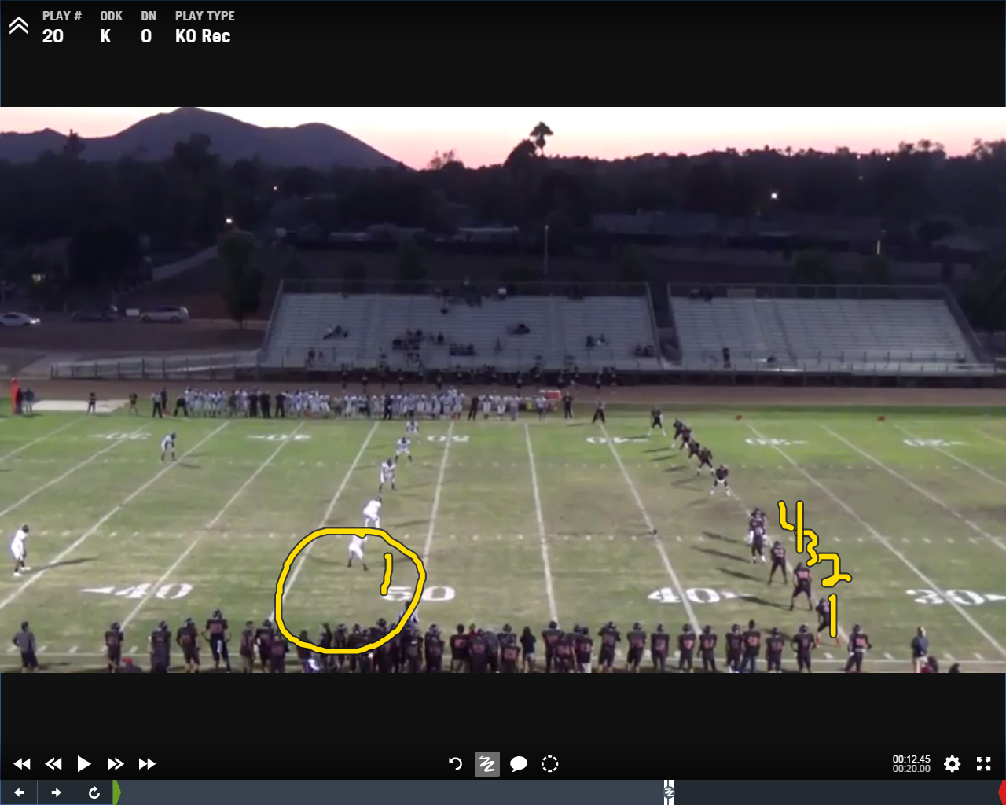

Slide 50
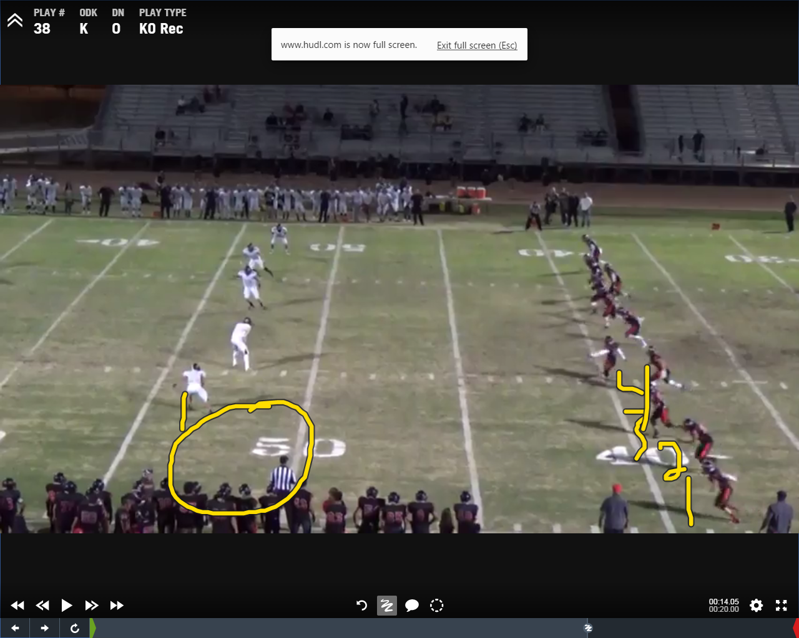

Slide 51
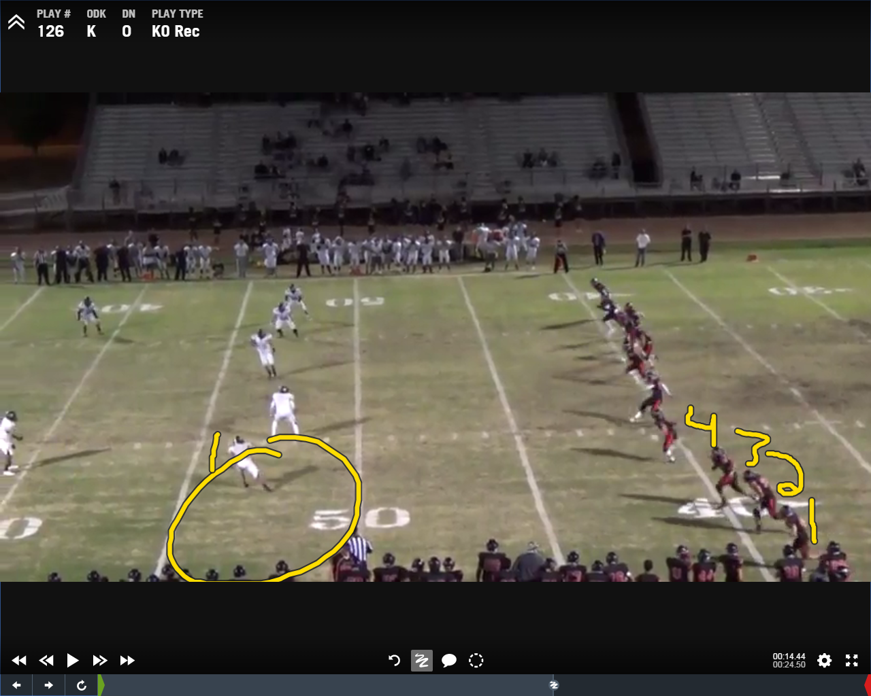

Slide 52
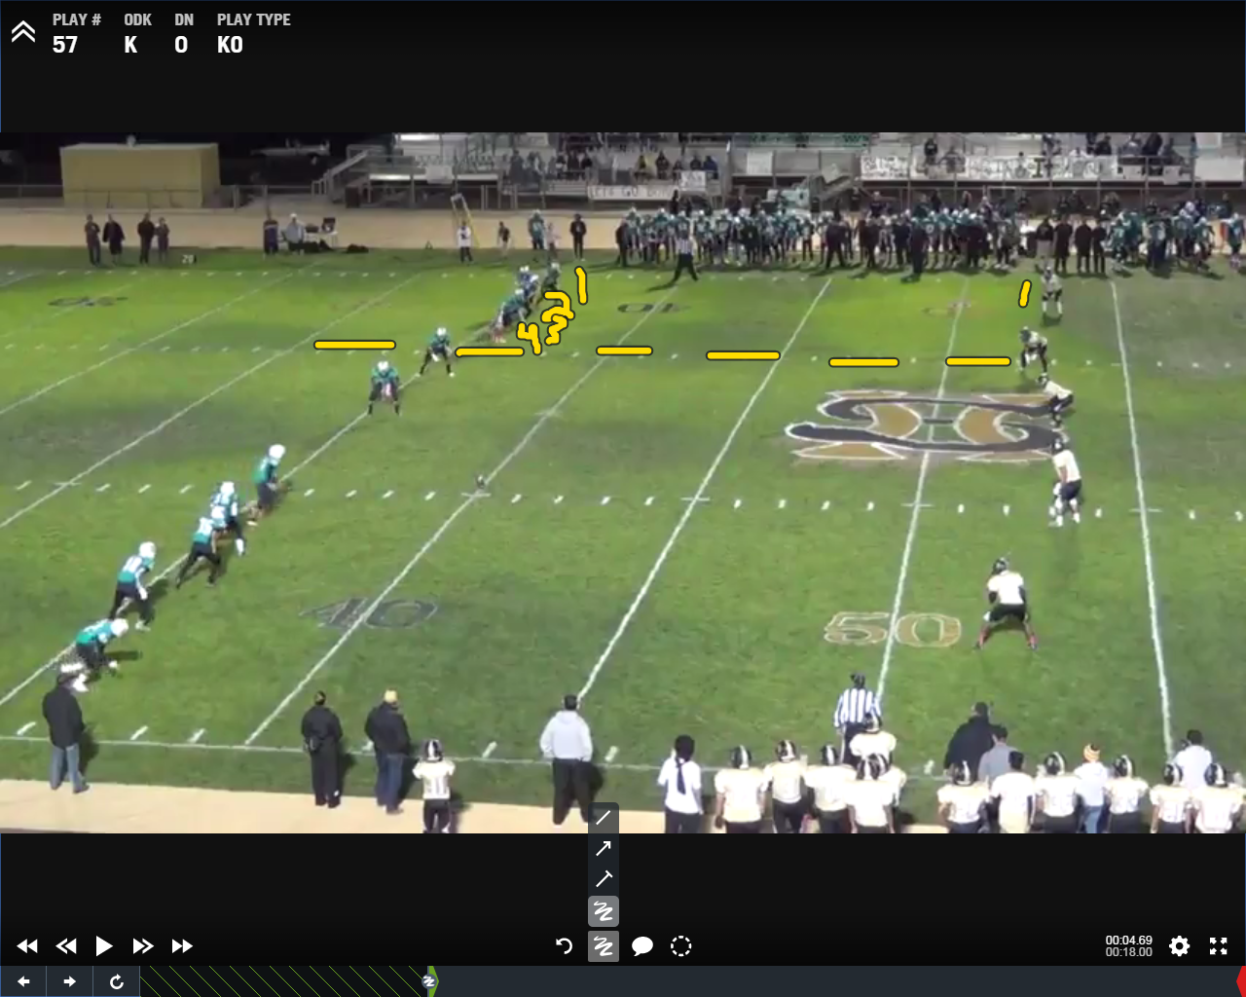
OUR GAME

Slide 53
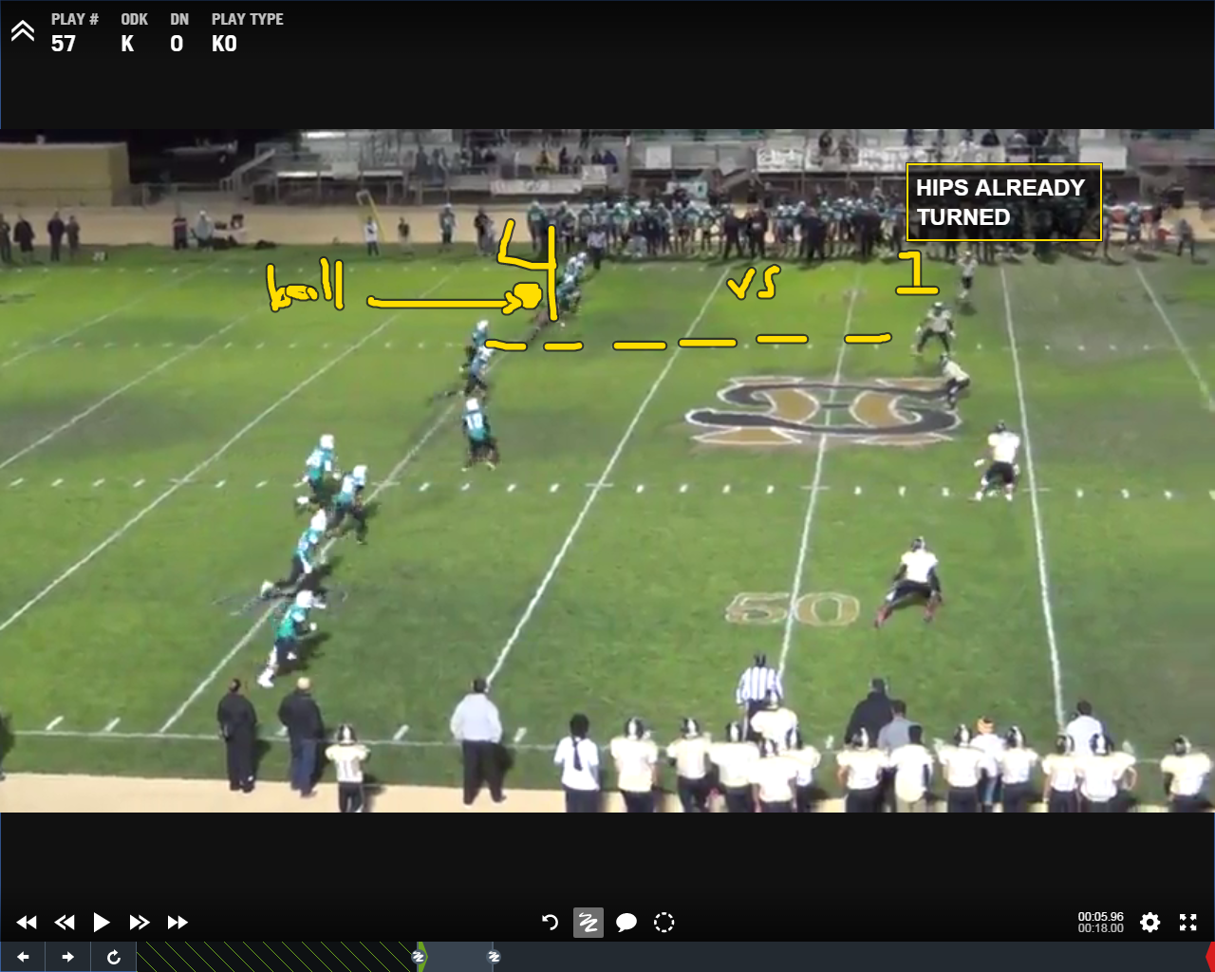

Slide 54
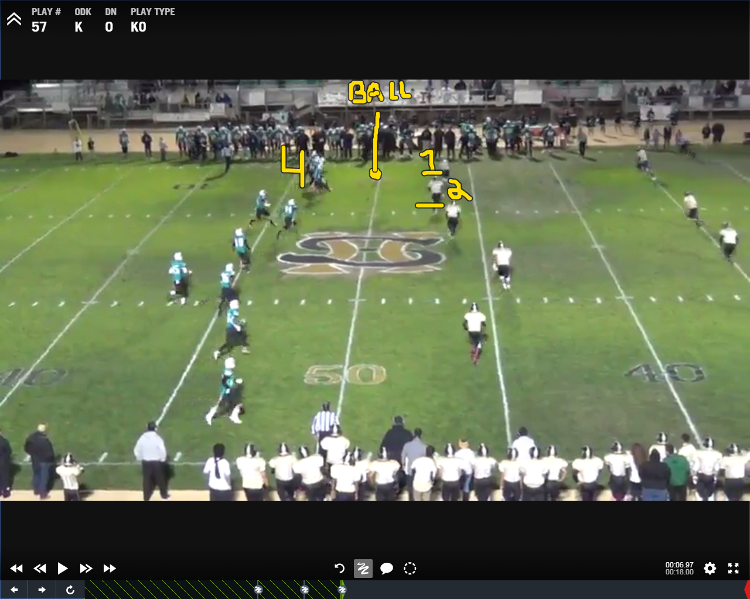

Slide 55
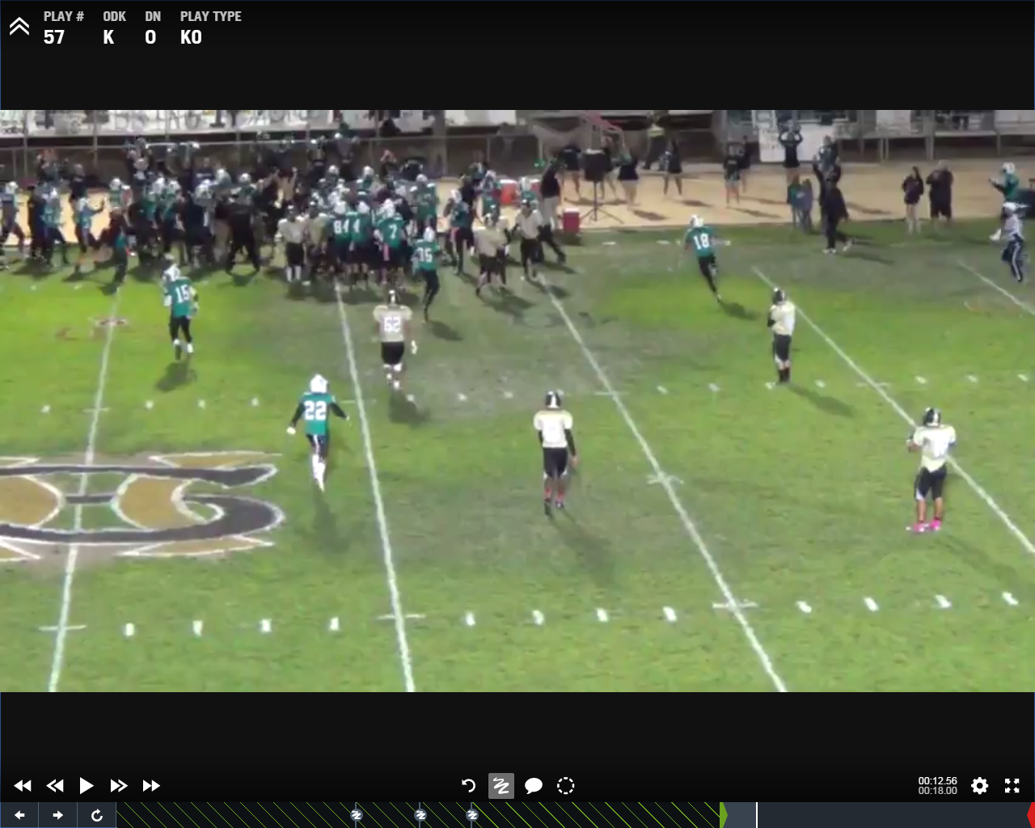

Slide 56
SCOUTING YOUR OPPONENT IN SEASON
2. Be diligent
Watch 4-5 games
Make a Special Teams playlist
Make notes on that for players/coaches
Where can you take advantage of what they are allowing?
What does their scheme give you?

Slide 57
OPPONENT’S KICKOFF
Scheme: 5-5, 4-6, 6-4
Kick from: middle, L/R hash?
Kicker – #, L/R, leg strength, ball direction
Average kick? – Make a “land” chart
Personnel: #s, same or change?
Best tackler? Count up the tackles
Onside kick schemes?
Pooch kick schemes?
Contain well?
What will expose them?
Speed vs our speed?

Slide 58
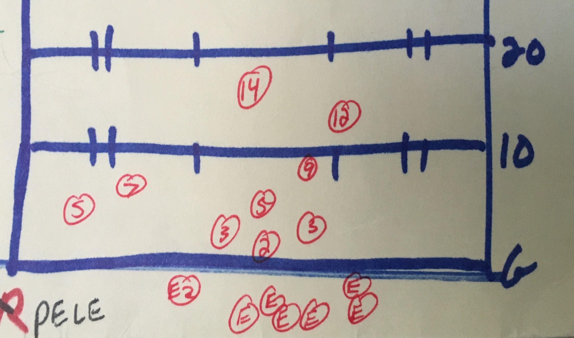
LAND CHART

Slide 59
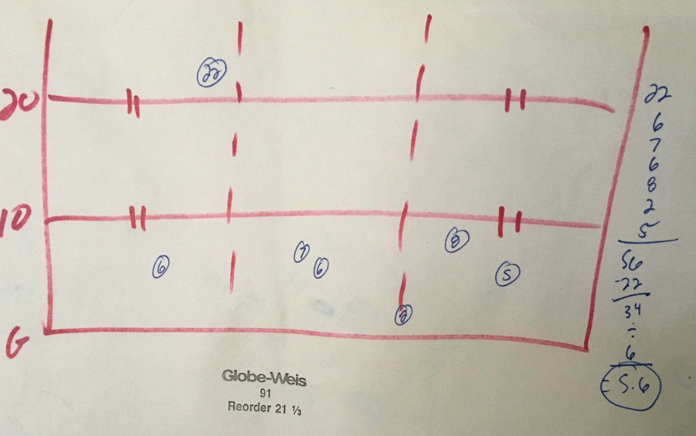
LAND CHART
5.6 yard average

Slide 60
OPPONENT’S KICK RETURN
Scheme: Middle, Sideline, Hash
Who are the returners?
Which one is better?
Where do returners line up?
Personnel: #s, same or change?
Best blockers?
Reverse?
Throwback?
What will expose them?
Speed vs our speed?

Slide 61
OPPONENT’S PUNT
Scheme: Pro, Shield, Twins, etc.
Field position change scheme?
Kicker – #, L/R, leg strength, ball direction, run ability?
Long Snapper - #, speed/accuracy of snaps, tackler?
Average kick distance? Hang time average?
Personnel: #s, same or change?
Best tackler? Count up the tackles
Can kicker throw the ball? Is he QB, or backup QB?
Fakes? Running? Passing?
Contain well?
What will expose them?
Speed vs our speed?

Slide 62
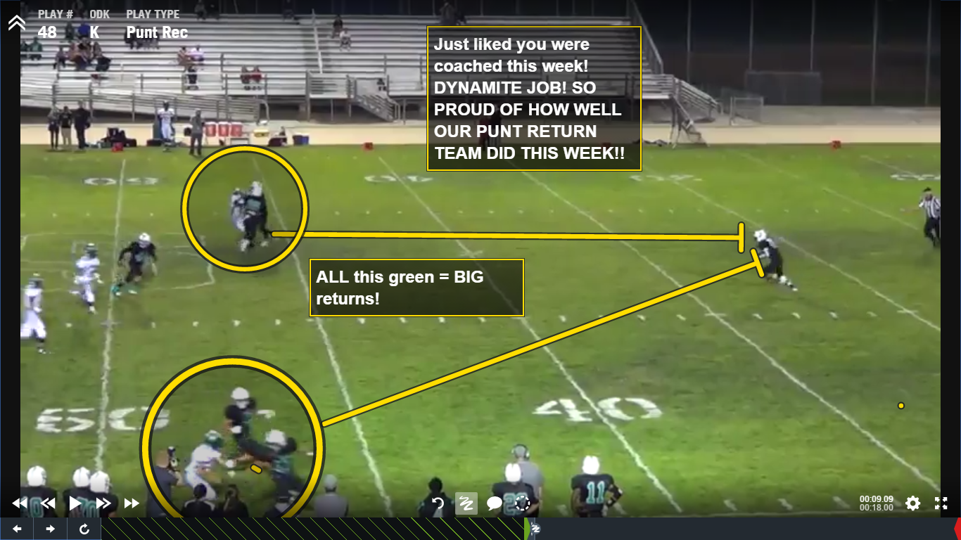

Slide 63
Returner
Gunner
Gunner

Slide 65
OPPONENT’S PUNT RETURN
Scheme: Man or Zone? Middle, sideline?
They like to set up returns? Or block?
Who are the returners? 1 or 2 deep?
Which one is better?
Where do returners line up?
Personnel: #s, same or change?
Reverses?
What will expose them?
Speed vs our speed?

Slide 66
OPPONENT’S PAT/EP
Scheme: Traditional or something else?
How are the wings angled?
Kicker – #, L/R, leg strength, run ability?
What is kicker’s long field goal?
Long Snapper - #, speed/accuracy of snaps
Holder - #, is he the QB? Backup QB?
Eligible receivers at TE/Wing spots?
Personnel: #s, same or change?
Fakes?
What will expose them?

Slide 67
DEVELOP A SNAPSHOT

Slide 68
EVALUATING YOUR SPECIAL TEAMS IN SEASON

Slide 69
DEVELOP A SNAPSHOT

Slide 72
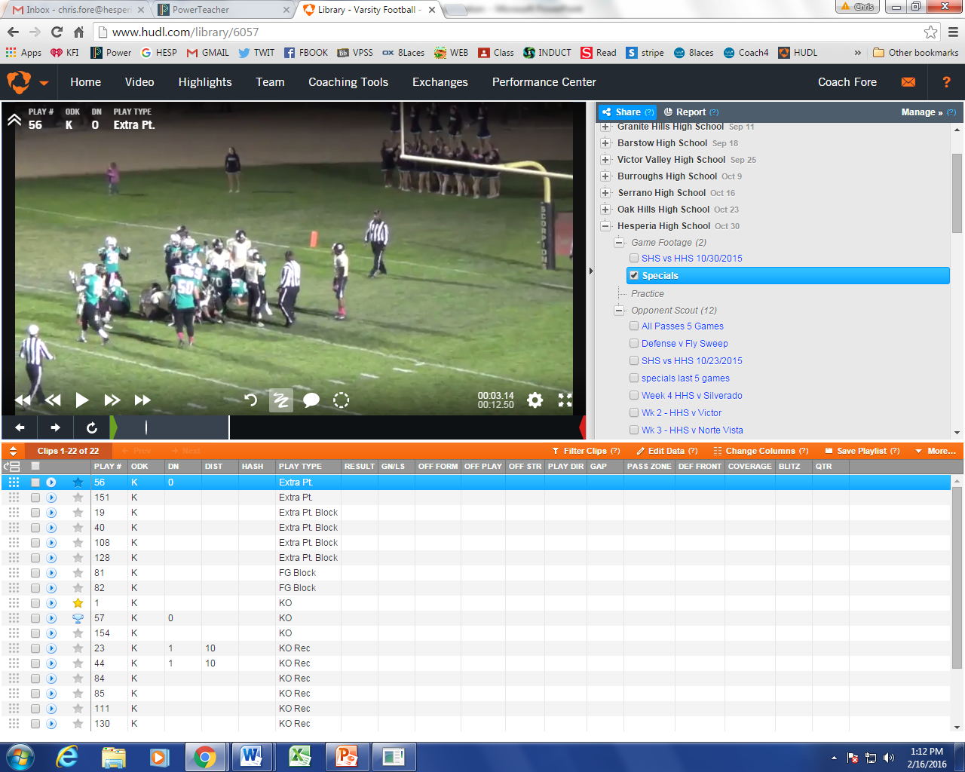

Slide 74
PLANNING FOR IN GAME CHAOS

Slide 76
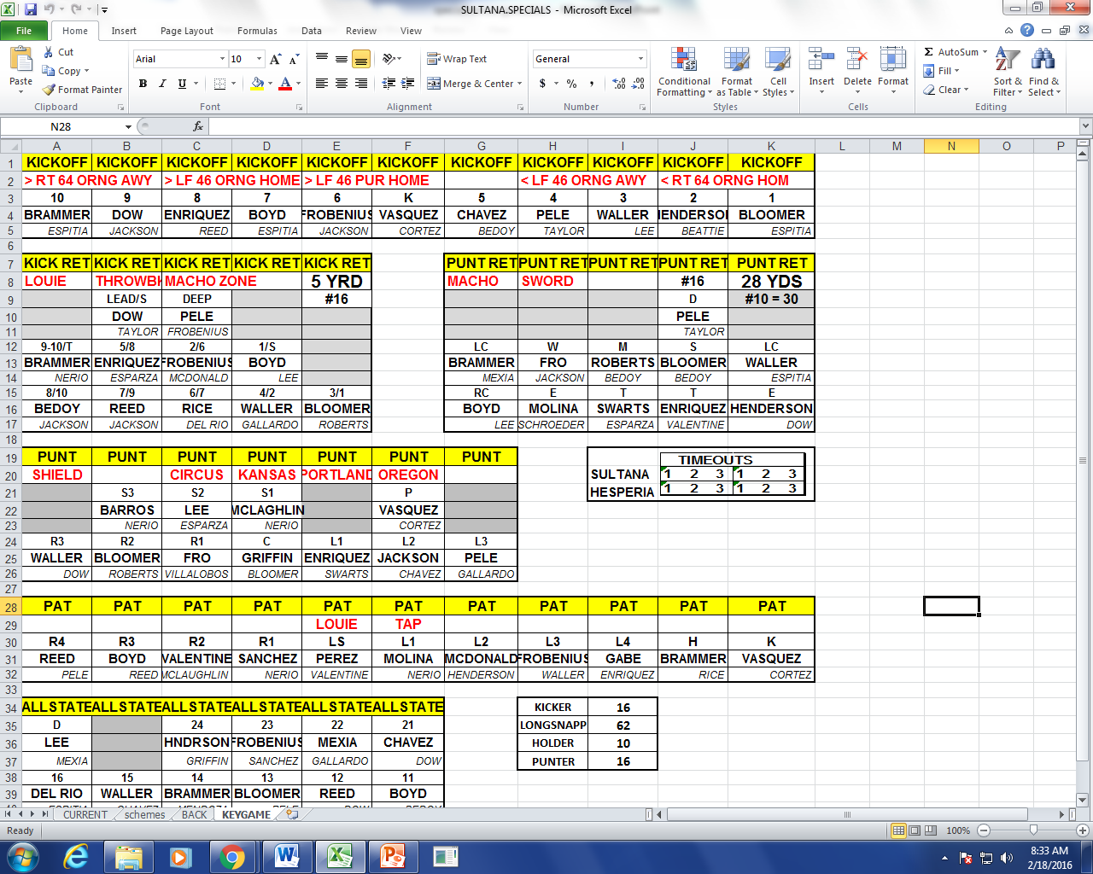

Slide 77
COACH

Slide 78
SPECIAL TEAMS PLAYER OF THE YEAR PROGRAM

Slide 87
CHRIS FORE
chris@eightlaces.org
760.900.8401
EIGHTLACES.ORG
COACHFORE.ORG
SHIELDPUNT.COM
@coachfore

